Slide 1
Budget Office
Cindy Patterson
Budget Director
x2353
Brooke Hallman
Assistant Budget Director
x2361
Notes:
Julie
Cindy

Slide 2
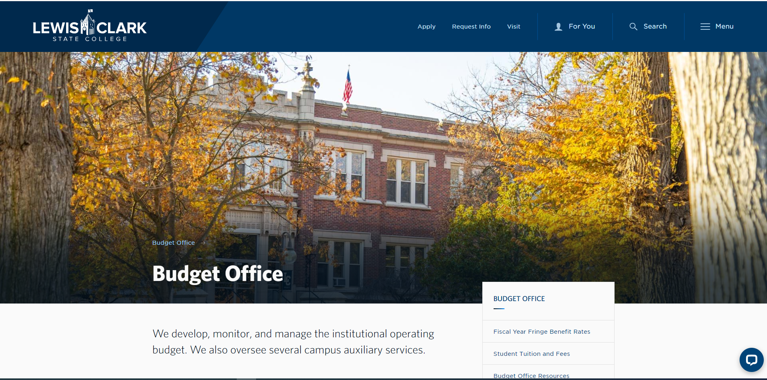
www.lcsc.edu/budget & LC Intranet - Home (sharepoint.com)
Notes:
Cindy

Slide 3
College Resources/Budget (Funds)
Appropriated fund sources
(Gen Ed fund 10, Normal School Endowment, CTE fund 12, CTE fund 14 major capital project funding)
Non-appropriated fund sources (local funds)
Student fees fund 11, local Service Ops, Grants & Contracts (Funds 20 & 21), Auxiliaries (Fund 3x series, Agency Funds (Fund 50)
Ongoing vs. one-time fund sources
Notes:
Julie

Slide 4
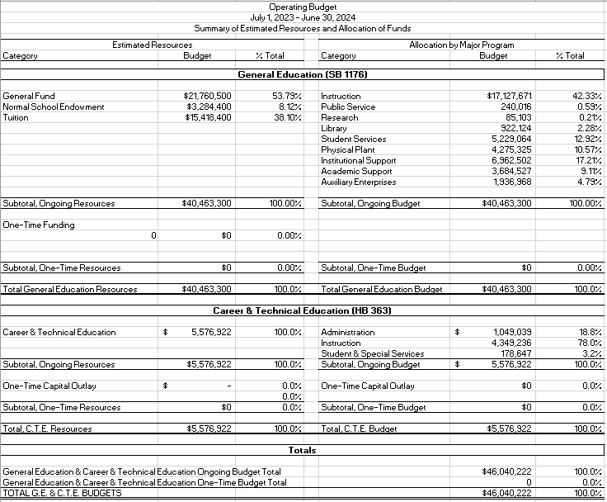
Budget Book (Approp. Funds)

Slide 5
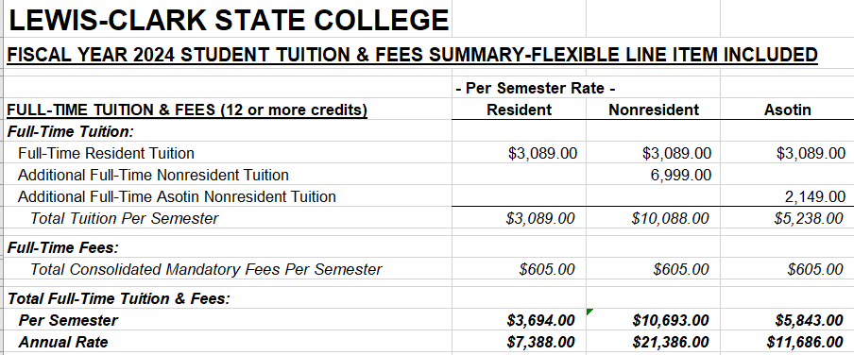
Notes:
Cindy

Slide 6
Dissection of an account# Fund-Function-Cost Center-Object
Ex: 10-10-903101-55000
Fund 10 tells me it is an appropriated account
Function 10 tells me the account’s purpose is institutional support (01 instruction, 04 research, 06 public service, 07 library, 08 student services, 09 plant operations, 11 academic support, 21 scholarships, and 30 auxiliary)
Account 903101 (903 beginning) tells me it belongs to administrative services; the 4 digit of 1 tells me it is appropriated
Notes:
Cindy

Slide 7
Financial Responsibility
Salary/Benefits – Institutional
Support Funds – Departmental (OE, IH, & CO)
Carryforward (75% department – 25% College)
Responsibility for deficits (100% department)
Notes:
Julie

Slide 8
Financial Decisions
Budget transactions (movements of budget (appropriated accounts))
Appropriated to Appropriated
Cannot increase or add funds to appropriated, set by the legislature
Accounting transactions (movements of cash—revenue and/or expense (local accounts))
Can move local expenses (NOT Funds) to appropriated
Notes:
Cindy

Slide 9
Managing your Budget/Resources
Tools for monitoring your unit’s budget
Colleague
Warrior Web Self Service: Budget To Actuals/Finance Query
Budget Status Reports
Budget Template
Taking corrective action
Contact the Budget Office
Budget transactions (Appropriated $ - Budget Office)
Accounting transactions (Local/Grant $ – Budget Office; Payroll $ - Controller’s Office/Payroll)
Notes:
Cindy

Slide 10
Questions?
Notes:
Both

