Slide 1

Emburse
Approval Process
Travel System

Slide 2
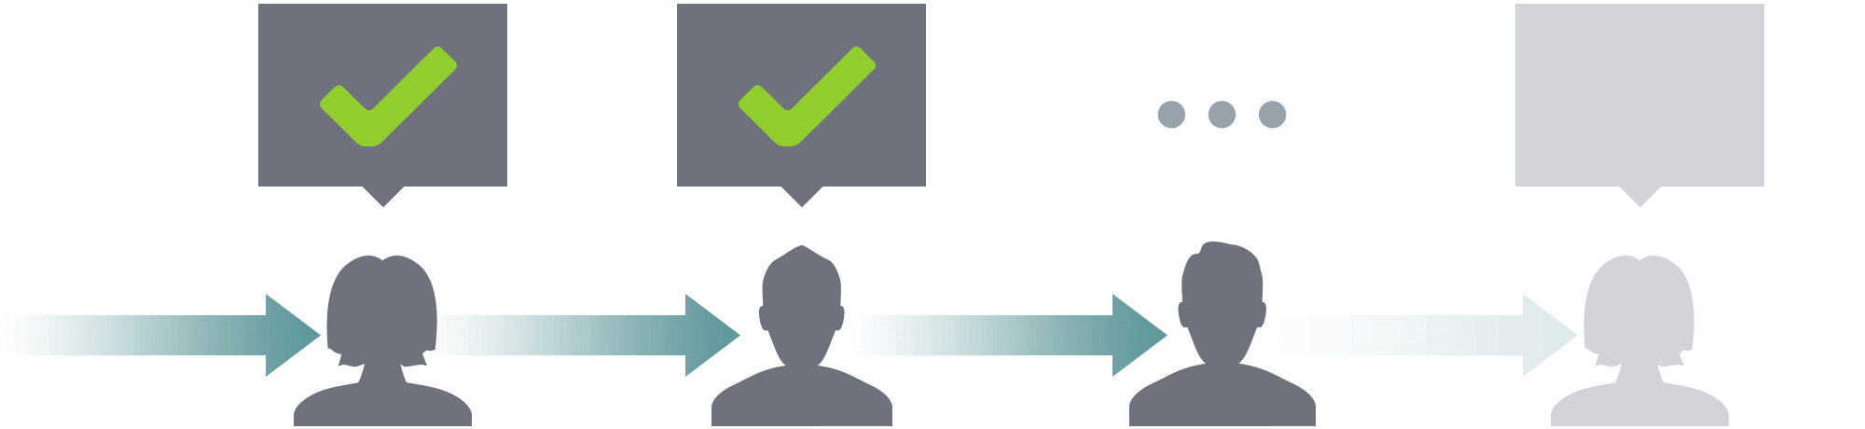

What’s changing?
No more hunting down PDF travel forms
No need to know the approval chain
Travel Authorizations are now called Pre-Approvals
Travel Claims are now called Expense Reports

Slide 3
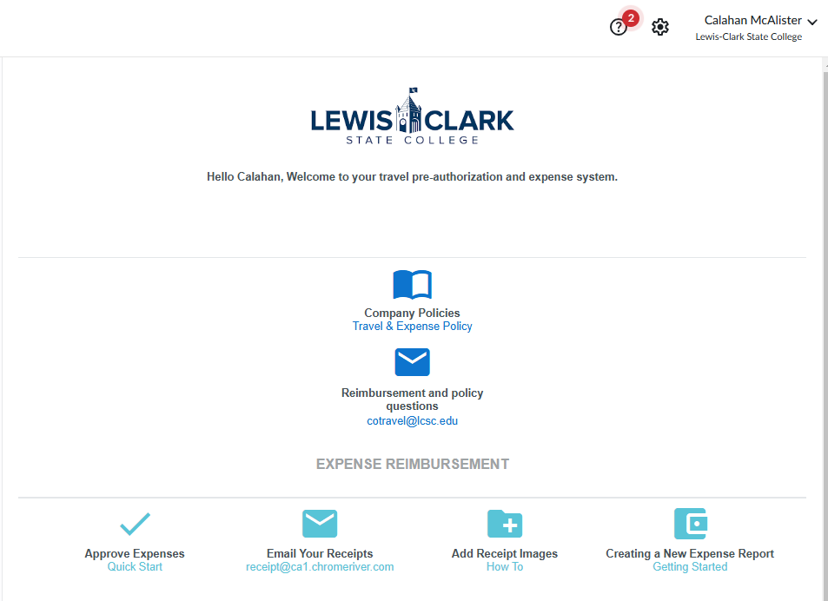
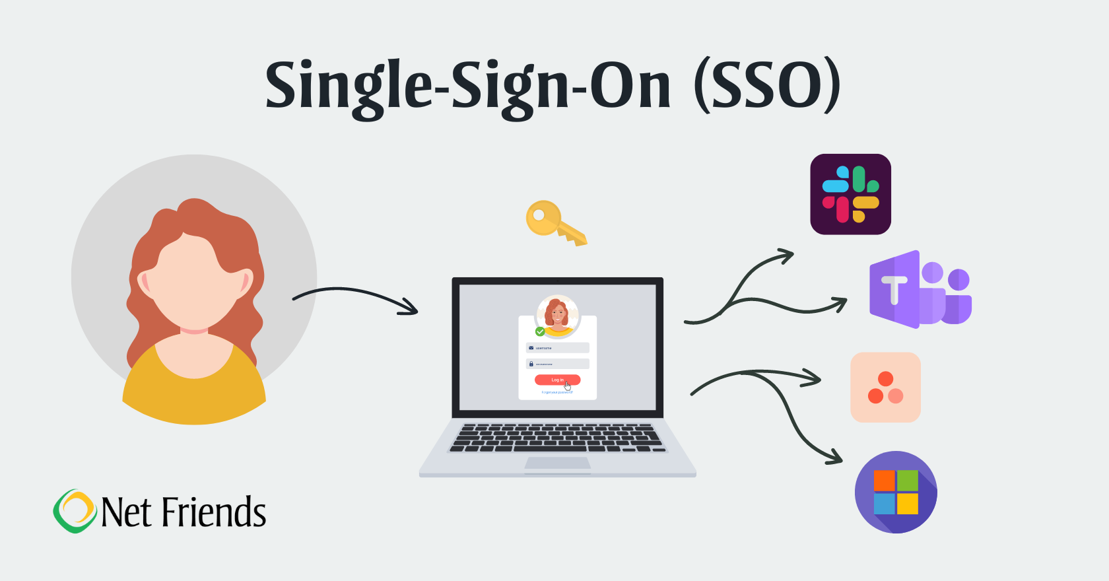

Logging Into Emburse- Production
Login will utilize single sign on verification
https://app.ca1.chromeriver.com/login/sso/saml?idp=lcsc.edu

Slide 4
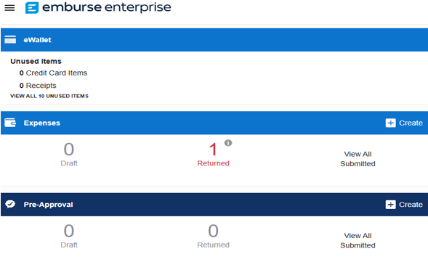
Quick and easy access all in one spot
At-a-glance view of status
Travel Policy & Help Videos
Travel Help
How To Video
Load
How To Video
Receipts

Slide 5
Quick and easy access all in one spot - continued
Create Pre-Approval or Expense Reports

Slide 6
Three ways to Approve
Through Email
On the Website
Through the App

Slide 7
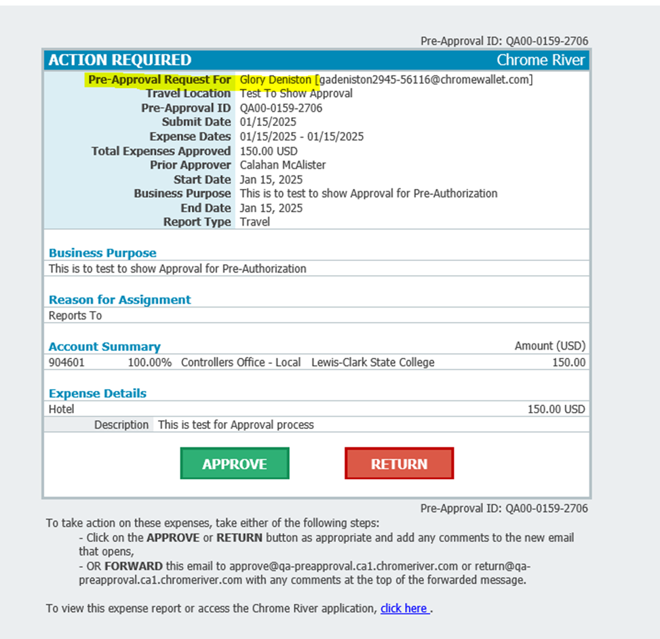
Approval Process by E-Mail
The approval process is as simple as approving an email.
The email provides the following information:
Type of approval (pre-approval or expense report)
Who the traveler is
Dates of travel
Total estimated expenses
Reason for the travel

Slide 8
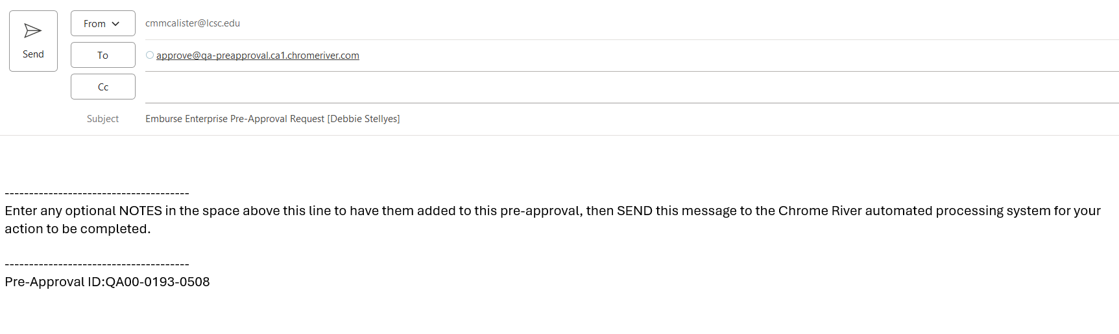
Approval Process by E-Mail Email Verification will populate to send to Emburse. No comments needed just hit the send button.

Slide 9
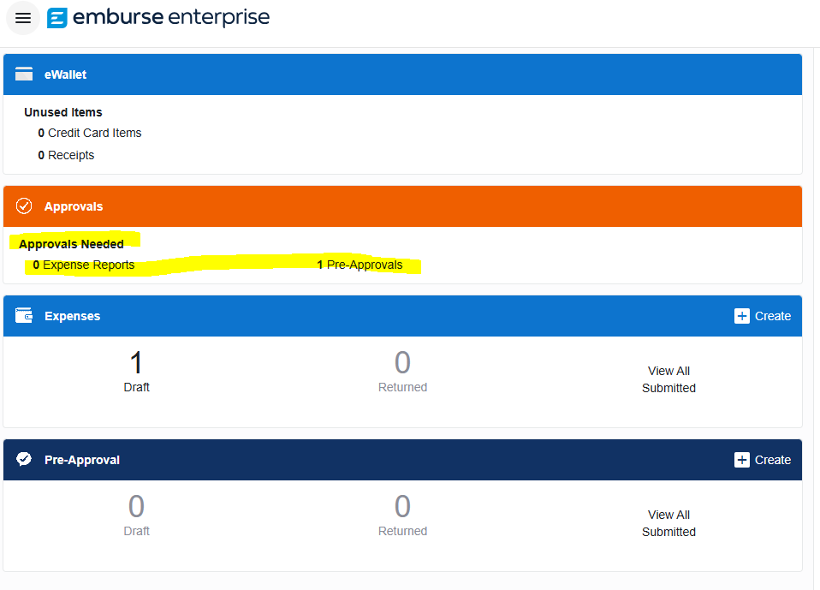
Approval Process by Website
Once clicked on Pre-approvals or Expense Reports, you will see a list of items requiring approval.​

Slide 10
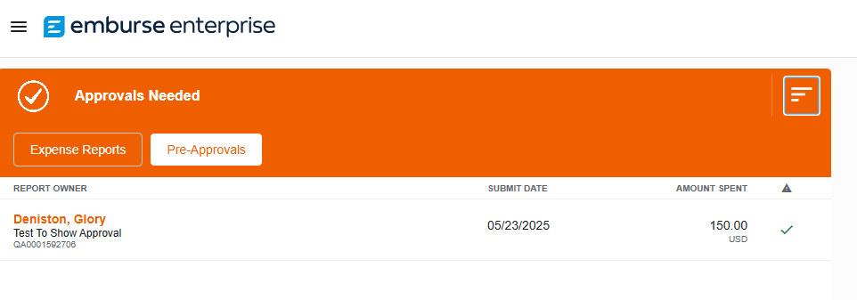
Approval Process by Website
This will show report traveler's name, description, ID#, date submitted and amount.
You can toggle between Expense Reports and Pre-Approvals by clicking on the type

Slide 11
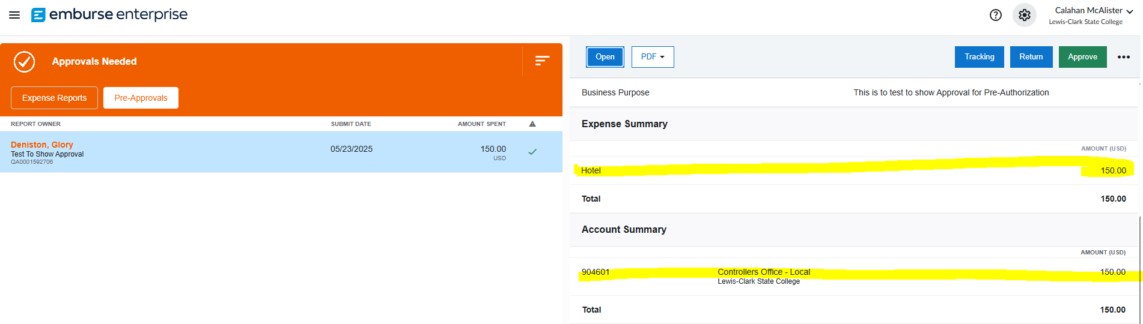
Approval Process by Website Summary Screen
When you click on name and scroll down you will see details for expenses and cost center assigned.

Slide 12
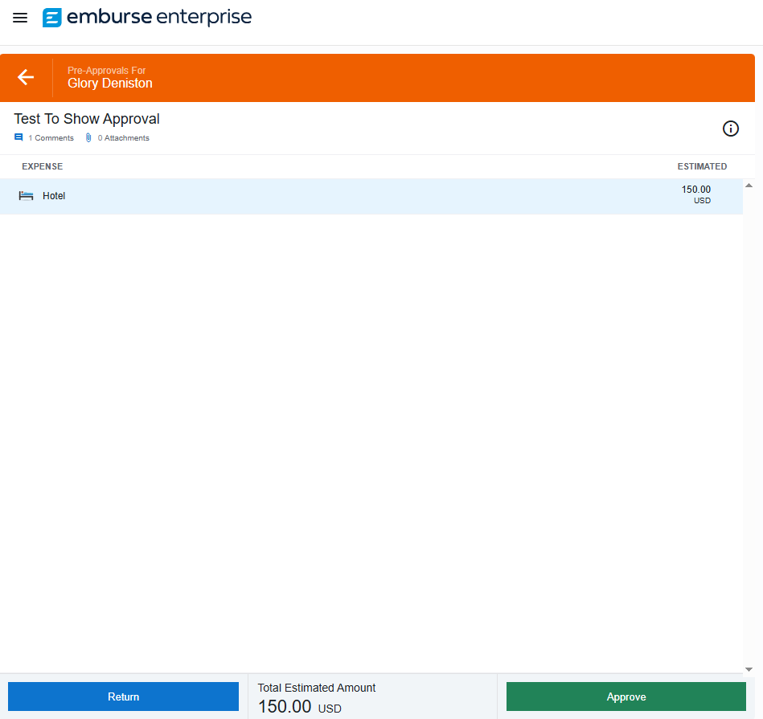
Approval Process by Website Detail Screen
If you double-click on the name will allow you to see list of expenses and grand total on the bottom a different way. The Cost Center information, travel details, and comments will be on the right-hand side of the screen.

Slide 13
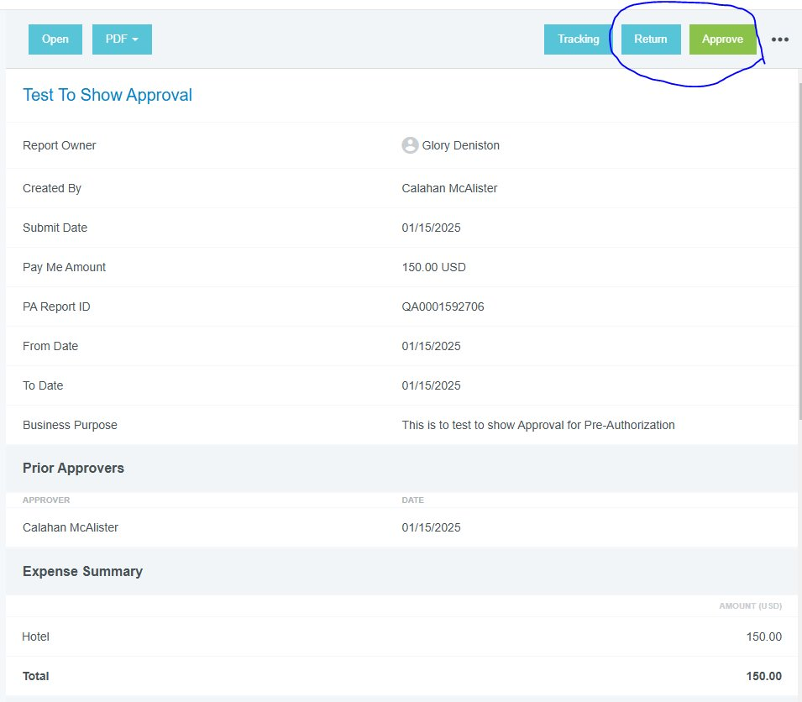
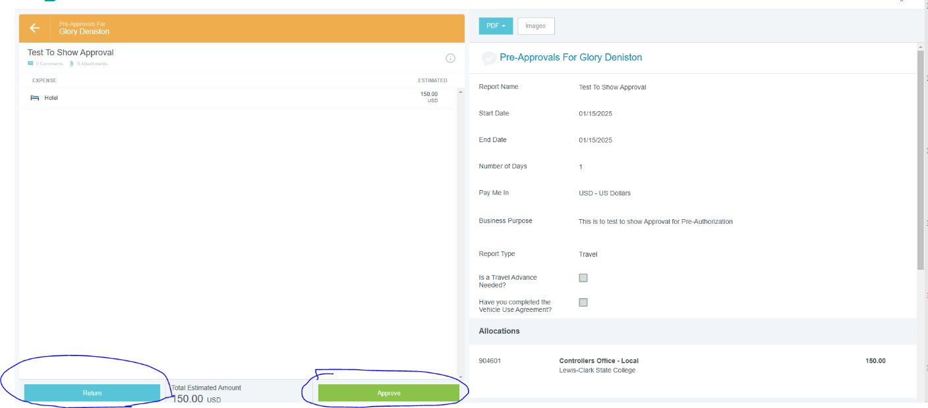
Approve or Return from either screen Summary Screen Detail Screen

Slide 14
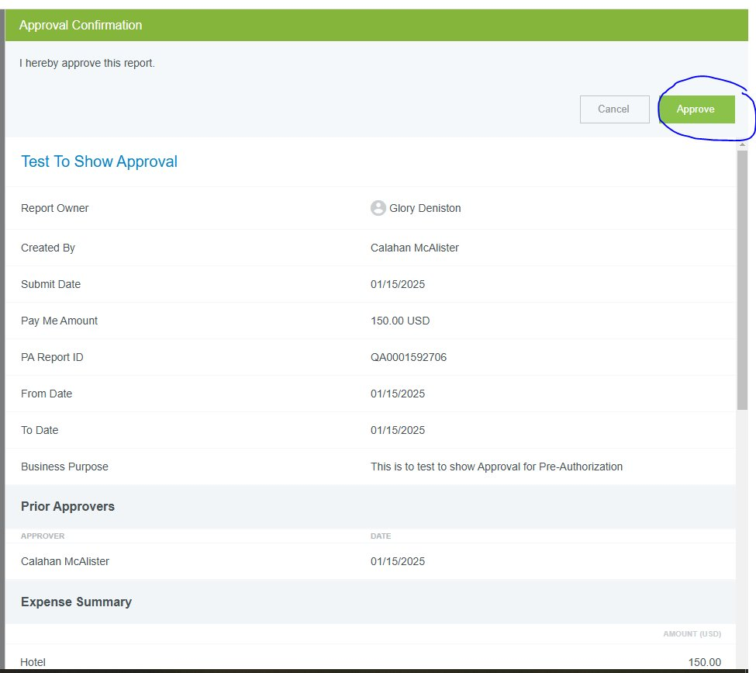
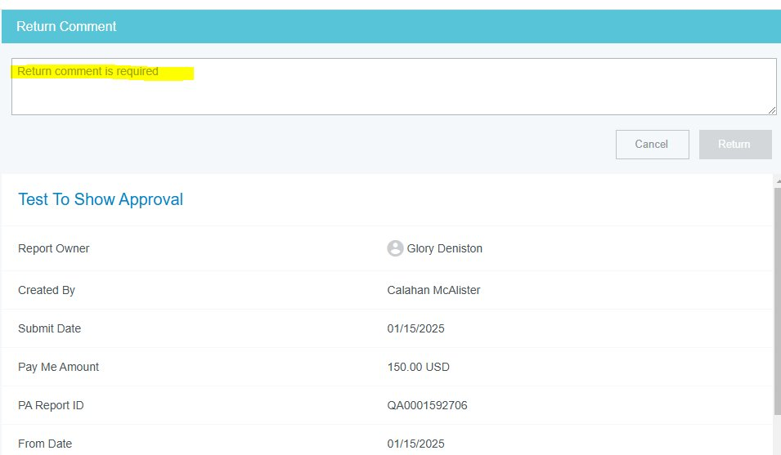
Verification Approval and Returns
Ensures the correct item being approved
Reports being returned require comments to be filled in

Slide 15
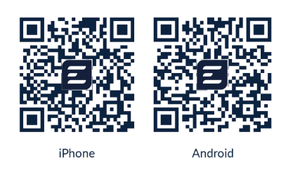
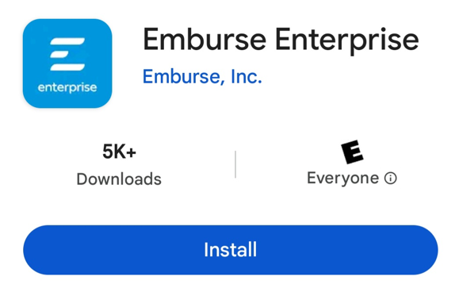
Emburse Enterprise App
(Only works with Production)
Download & Log In to Emburse Mobile App​
https://help.mobile.emburse.com/hc/en-us/articles/14257401226637-Download-and-Log-In-to-Emburse-Enterprise-Mobile
Use Single Sign On log in information
Use Full LCSC email EX CMMCALISTER@LCSC.EDU​
Password to computer log in
Might require DUO Verification

Slide 16
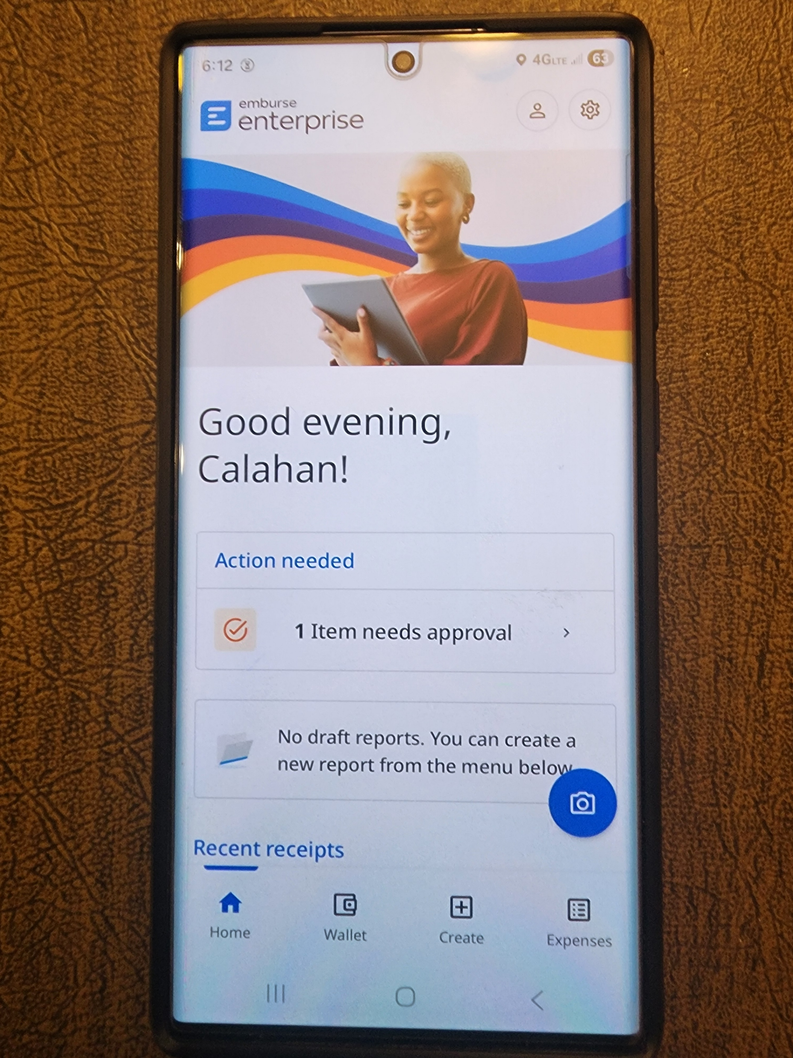
Approval by App
Approval on the Go
This will show how many are pending approval.

Slide 17
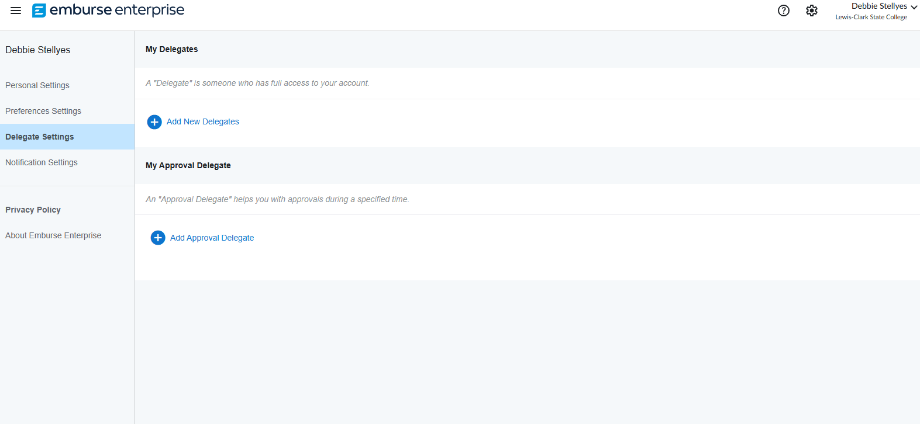
Assigning Delegates
Assign Pre-Authorization or Expense Report delegate (multiple)
Assign approval delegate (only one)
Start and end dates required
Click on your name – upper right-hand corner
Account settings
Delegate settings (left side)

Slide 18

Thank you. Questions?
COTravel@lcsc.edu
208-792-2689

