Slide 1

Emburse
Expense Report Process
Travel System

Slide 2
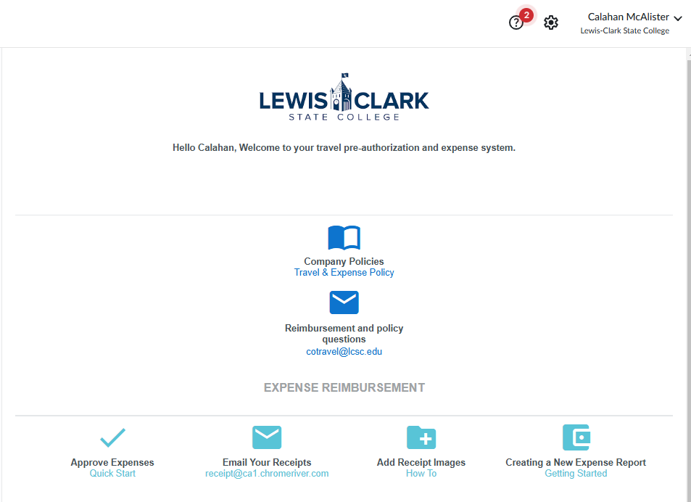
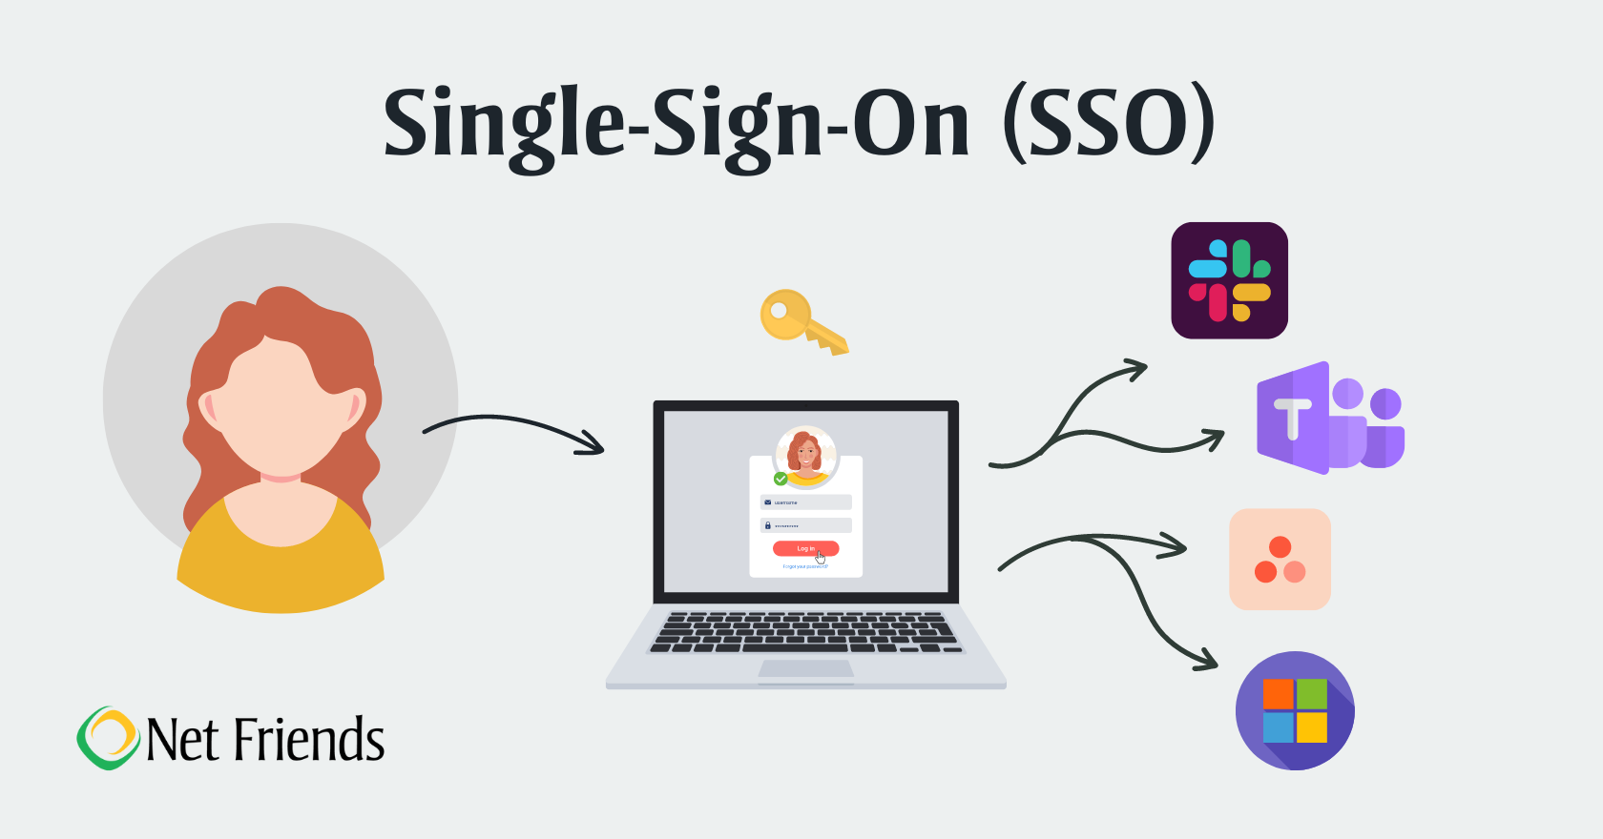


Logging Into Emburse- Production
Login will utilize single sign on verification
https://app.ca1.chromeriver.com/login/sso/saml?idp=lcsc.edu

Slide 3
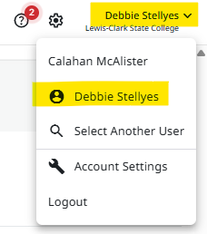
If submitting as Delegate
If you are an assigned delegate, make sure to click on your name in top right-hand corner and select person you would like to submit Expense Report for. Once selected, the top right-hand name will show the person’s name you are submitting for.

Slide 4
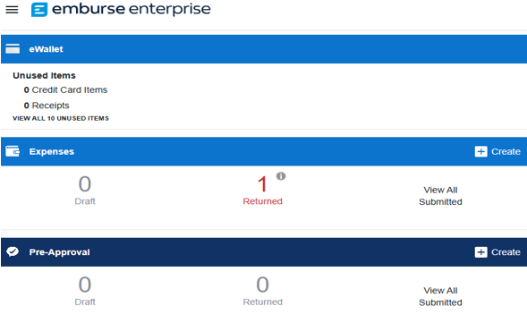
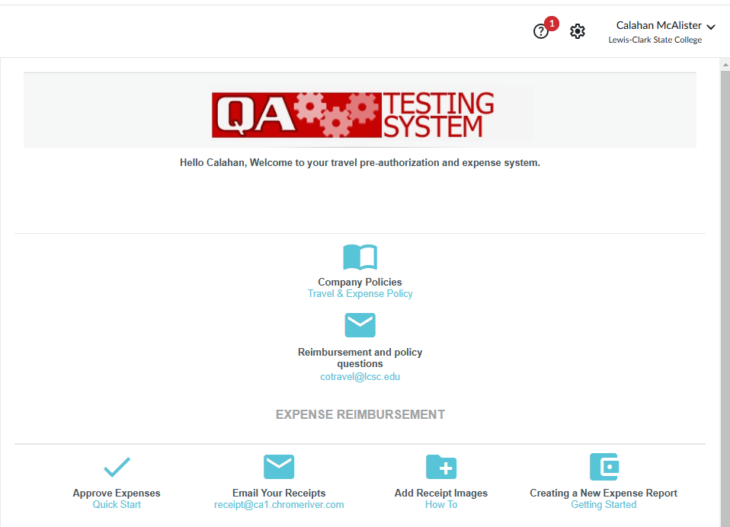
Creating Expense Report
Use Create button to start an Expense Report

Slide 5
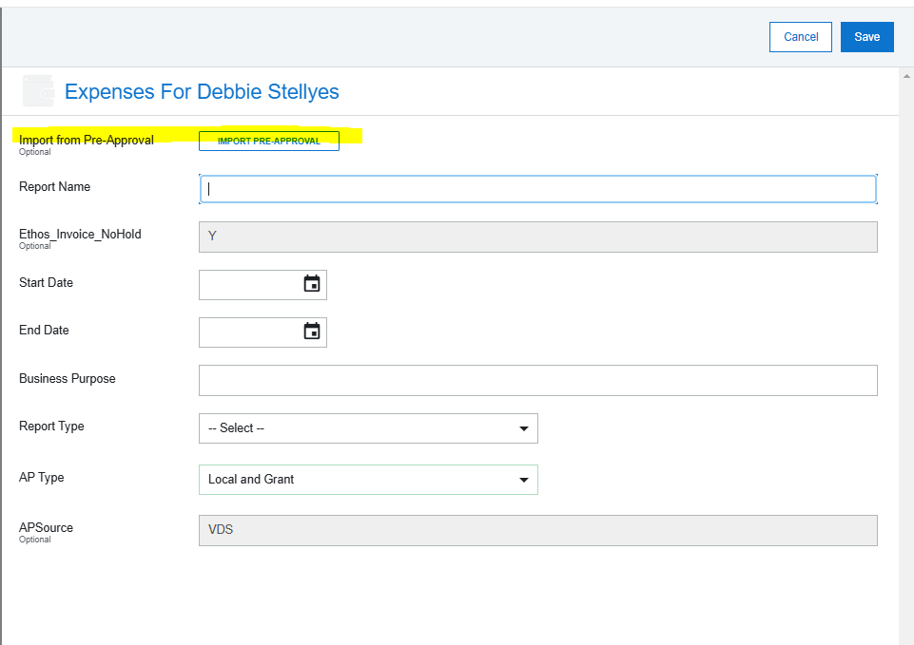
Creating Expense
Report
Select import Pre-Approval
***All Expense reports, except for Cash Advance, will need a Pre-Approval imported***

Slide 6
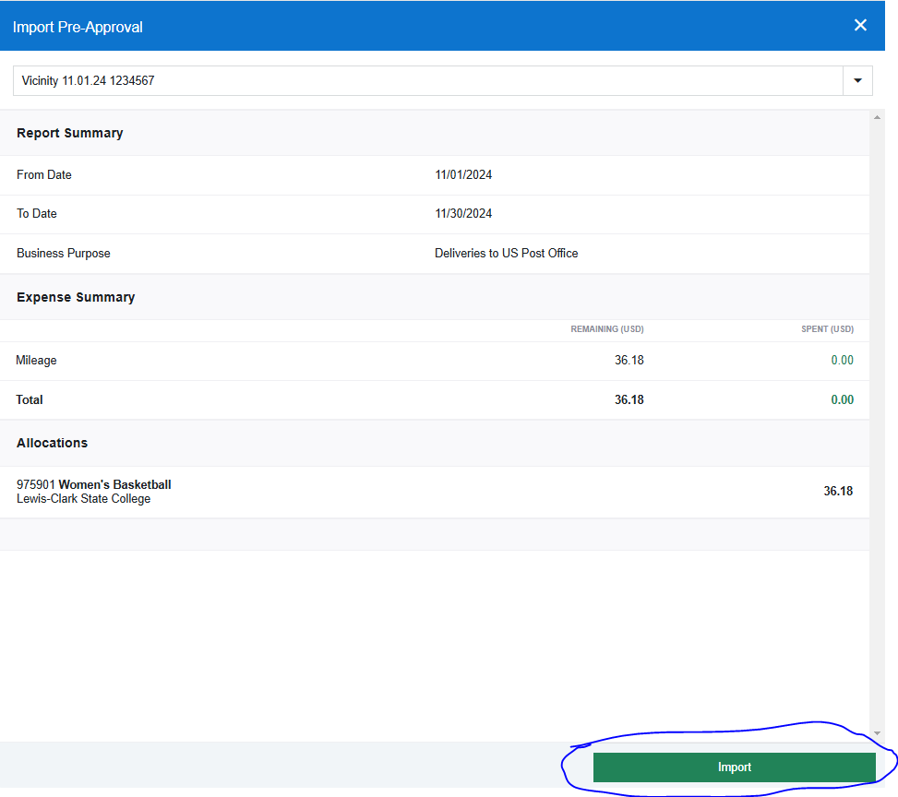
Creating Expense
Report
Once Pre-Approval is selected from the drop-down menu, Click Import on bottom right corner.
This drop-down menu will show all Pre-Approvals available to attach to an Expense Report.

Slide 7
Creating Expense
Report
Make sure to select correct AP Type that is associated with Cost Center that is going to be
charged.
- Appropriated (Fund 10 Only)
- Appropriated and Local/Grant
- Local and Grant
If the 4th number on the Cost Center is a one (1) it is an appropriated account.
EX 904102

Slide 8
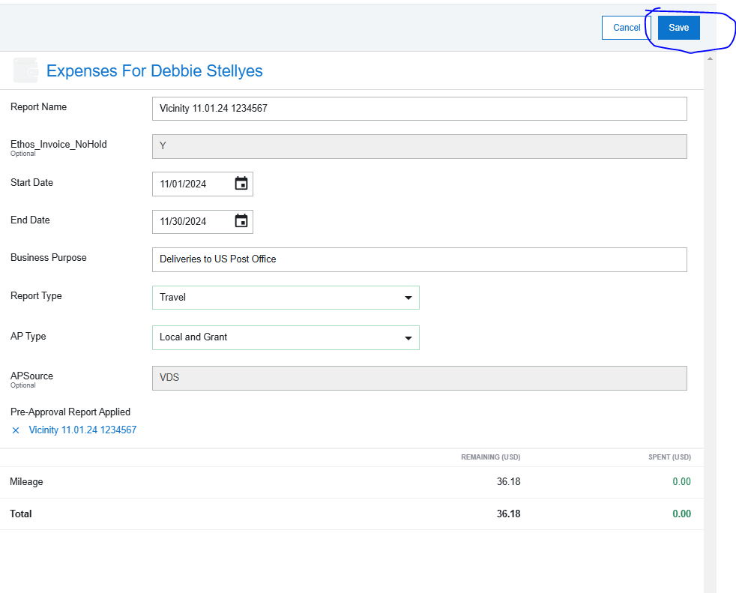
Creating Expense
Report
Click Save on top right-hand corner

Slide 9
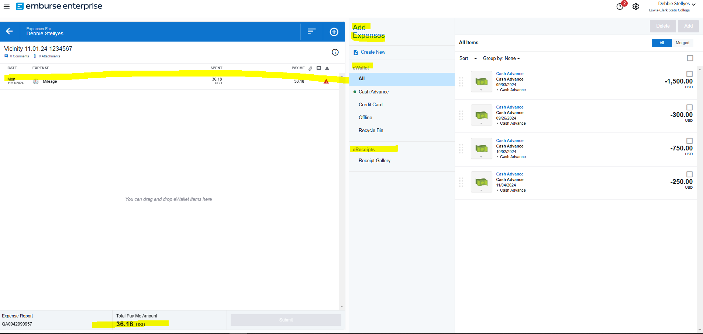
Creating Expense
Report
Once loaded you will see all expense on left hand side and options to create new expenses, add expenses from eWallet and eReceipts on right hand side

Slide 10
Creating Expense
Report
If you notice anything with warning triangle next to it, this means more information is required.

Slide 11
Creating Expense
Report
For Per Diem you must adjust using the wizard to fix any changes from full day to partial day. Click on one Meal-Per Diem line to start to adjust.

Slide 12
Creating Expense
Report
Click View in Wizard

Slide 13
Creating Expense
Report
Adjust Per Diem that is not getting paid by clicking on box next to breakfast, lunch, or dinner. Anything getting paid by Per Diem should be unchecked. Click apply when done.

Slide 14
Creating Expense
Report
Baggage Fees: Click on the line and edit on the top right side. You will need to
complete the following;
1- Adjust total Spent if need to
2- Type in Location = United States (if in the US)
3- Attach a receipt by clicking on Add Attachments on the bottom.
4- Click Save on the top right and warning should go away for this line item
If paid by p-card and not going to be reimbursed to employee, delete the
transaction and make a notation in the comments box on main screen, attaching a
copy of the receipt at that time.

Slide 15
Creating Expense
Report
Hotel: Click on the line and edit on the top right side. You will need to complete
the following;
1- Adjust total Spent if need to
2- Type in Location = United States (if in the US)
3- Merchant: This is the hotel that you stayed at
4- Location is the City and State the hotel is at
5- Fill out Check in/Check out date.
6 - Attach a receipt by clicking on Add Attachments on the bottom.
7- Click Save on the top right and warning should go away for this line item
If paid by p-card or direct bill and not going to be reimbursed to employee, delete the
transaction and make a notation in the comments box on main screen, attaching a
copy of the receipt at that time.

Slide 16
Creating Expense
Report
Conference/Seminar: Click on the line and edit on the top right side. You will
need to complete the following;
1- Adjust total Spent if need to
2- Type in Location = United States (if in the US)
3- Attach agenda and registration receipt for event clicking on Add Attachments
on the bottom
4- Click Save on the top right and warning should go away for this line item
If paid by p-card and not going to be reimbursed to employee, delete the
transaction and make a notation in the comments box on main screen, attaching a
copy of the receipt at that time.

Slide 17
Creating Expense
Report
Airfare: Click on the line and edit on the top right side. You will need to complete
the following;
1- Adjust total Spent if need to
2- Type in Location = United States (if in the US)
3- Airline is the airline traveled with
4- Class- Should be Economy/Coach
5- Attach a receipt by clicking on Add Attachments on the bottom
6- Click Save on the top right and warning should go away for this item
If paid by p-card or direct bill and not going to be reimbursed to employee, delete the
transaction and make a notation in the comments box on main screen, attaching a
copy of the receipt at that time.

Slide 18
Creating Expense
Report
Notice all warnings are gone. If there was any p-card or direct bill related to this travel, make sure to attach to the report.

Slide 19
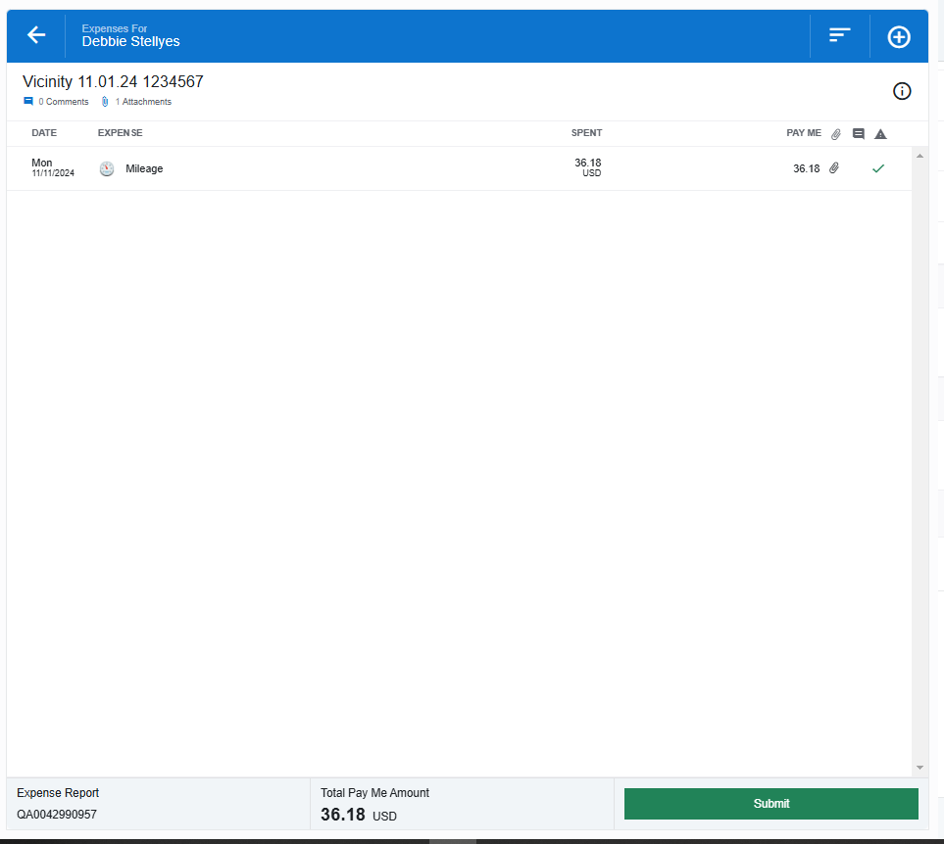
Creating Expense
Report
If items paid by P-Card or Direct Bill.
Click on Report Name on top left-hand corner.

Slide 20
Creating Expense
Report
Attach any additional receipts for expenses paid by p-card or direct bill related to this travel and make a comment regarding those expenses. Comment example hotel and airfare paid by p-card.

Slide 21
Original Receipts
Original receipts will no longer be required to be submitted with the expense report in Emburse Enterprise. A copy of the receipt attached is sufficient. However, the department will be required to keep the original receipts per the retention policy. This Policy is 4.103 Records Retention has links to Retention Schedules.

Slide 22
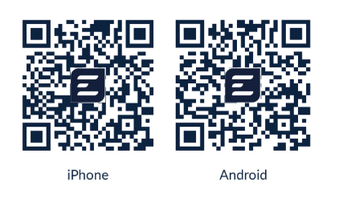
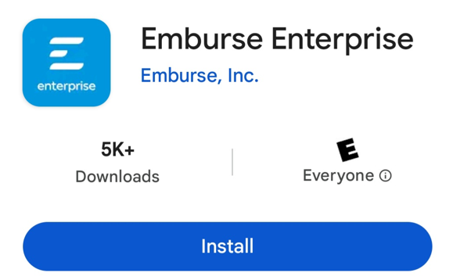
Emburse Enterprise App
(Only works with Production)
Download & Log In to Emburse Mobile App​
https://help.mobile.emburse.com/hc/en-us/articles/14257401226637-Download-and-Log-In-to-Emburse-Enterprise-Mobile
Use Single Sign On log in information
  Use Full LCSC email EX CMMCALISTER@LCSC.EDU​
  Password to computer log in
  Might require DUO Verification

Slide 23
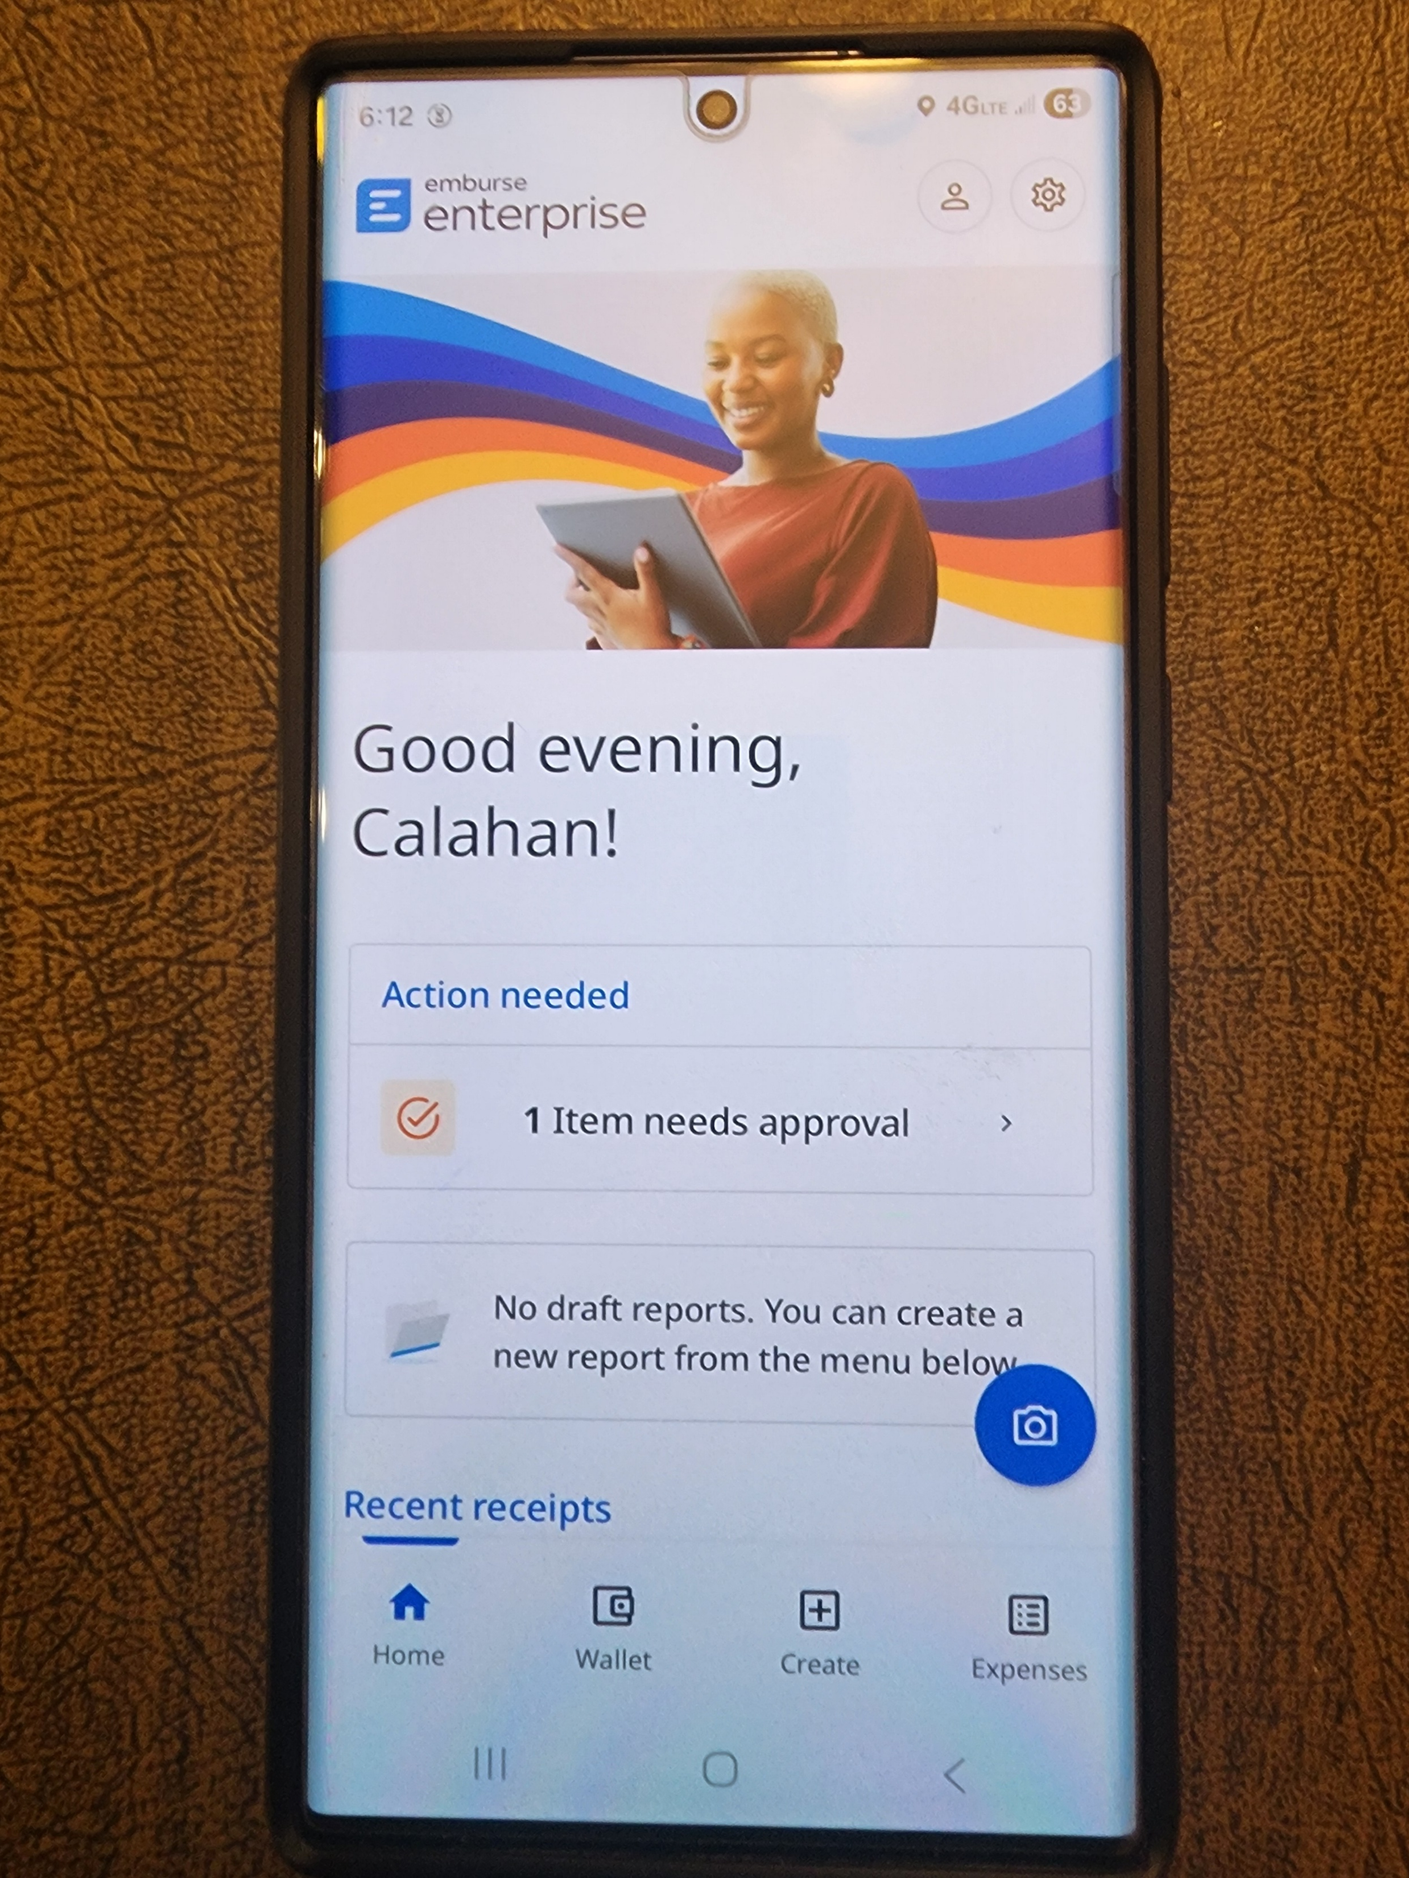
App Advantage
  Receipts on the Go
Load receipt(s) immediately
Helps keep receipts organized while traveling
Can be labeled for easy tracking and identification
Available in your wallet within Emburse
Receipt is removed from your wallet once it is attached to an expense claim

Slide 24
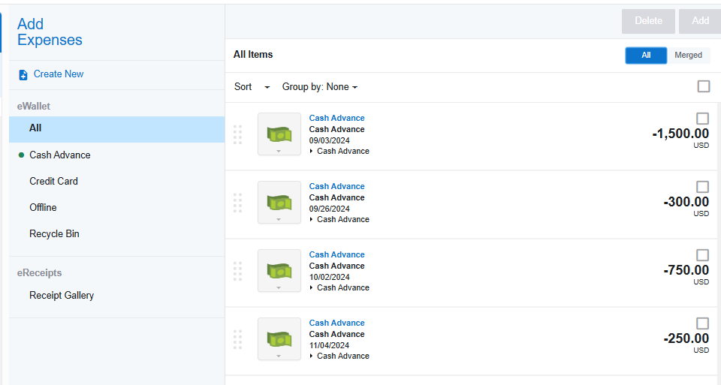
Creating Expense
Report
Use right hand side to add expenses that are missing or additional to expense report. EX: Cash Advance or additional expenses by clicking Create New

Slide 25
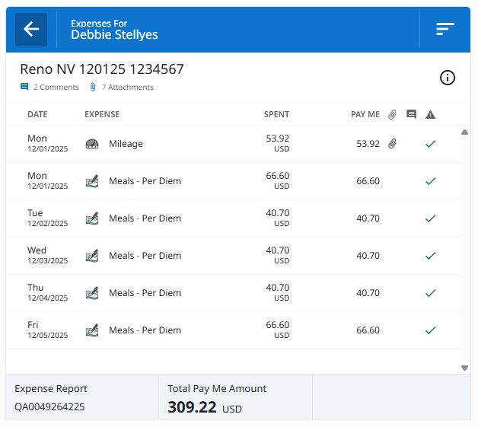
Before Clicking Submit
Double check report
You will see
  Title of Expense Report
  Expense Break down
  Report ID
  Total Expenses

Slide 26
Click Submit

Slide 27
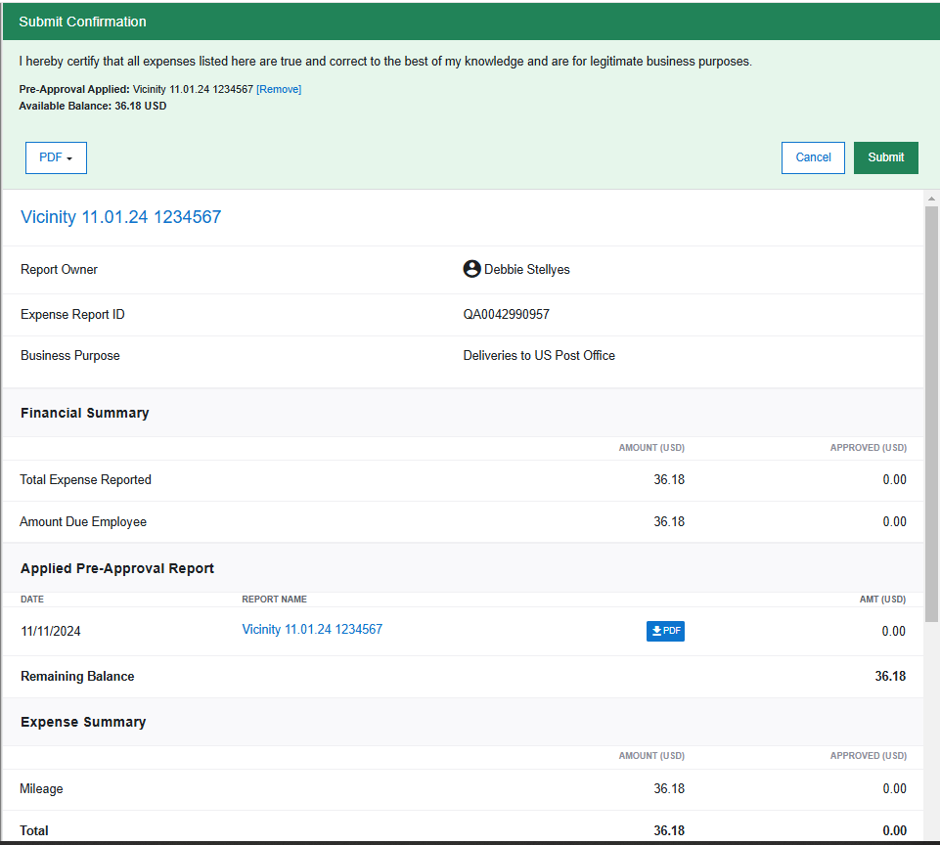
Verification Approval

Slide 28
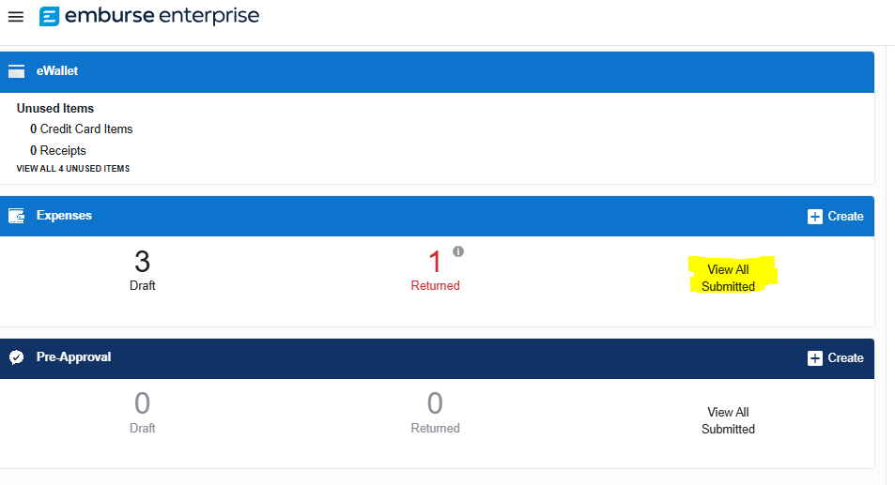
Tracking your items
An expense report can be tracked to see where it is in the process.

Slide 29
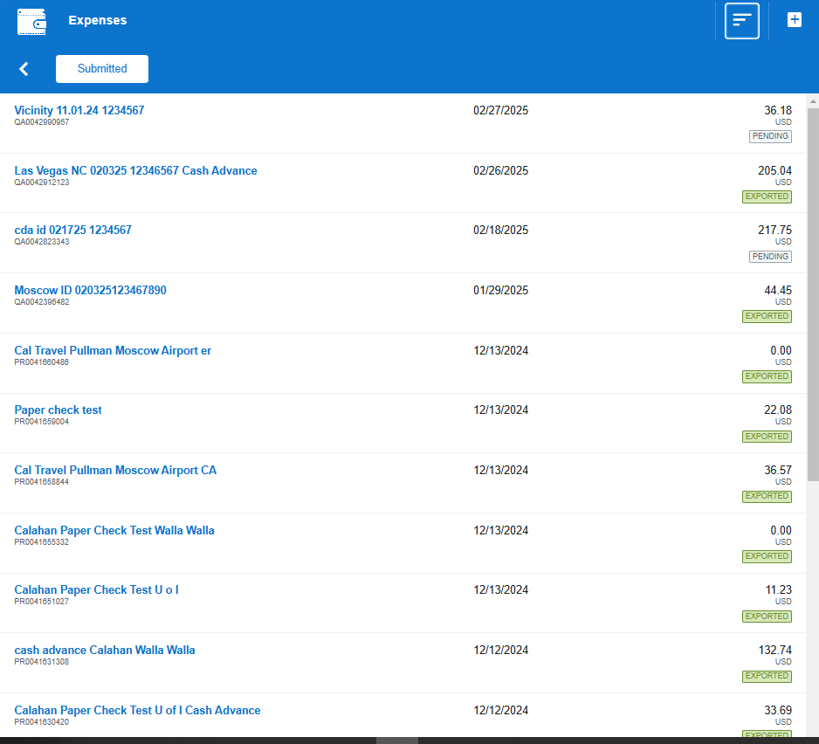
Tracking your items
A list will appear with all reports
  Name of each report
  Report ID number
  Date Submitted
  Total of expenses
  Status of report

Slide 30
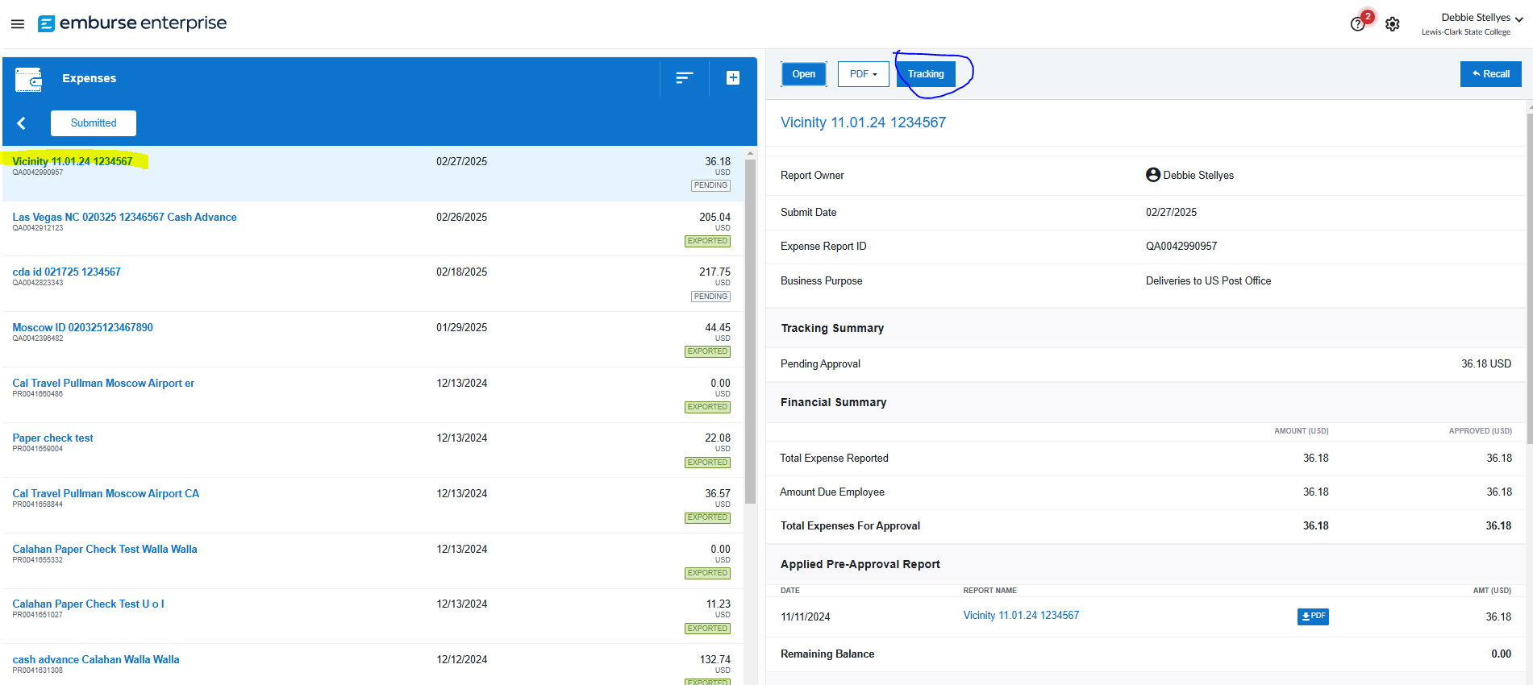
Tracking your items
Select from list and click on Tracking

Slide 31
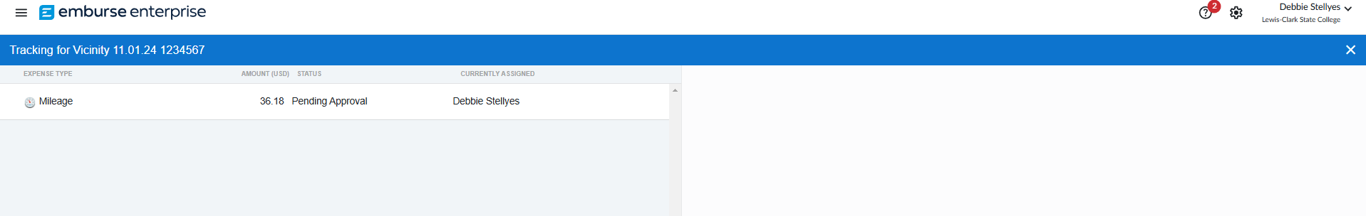
Tracking your items
List of expenses will show on left side. Click once to bring up tracking

Slide 32
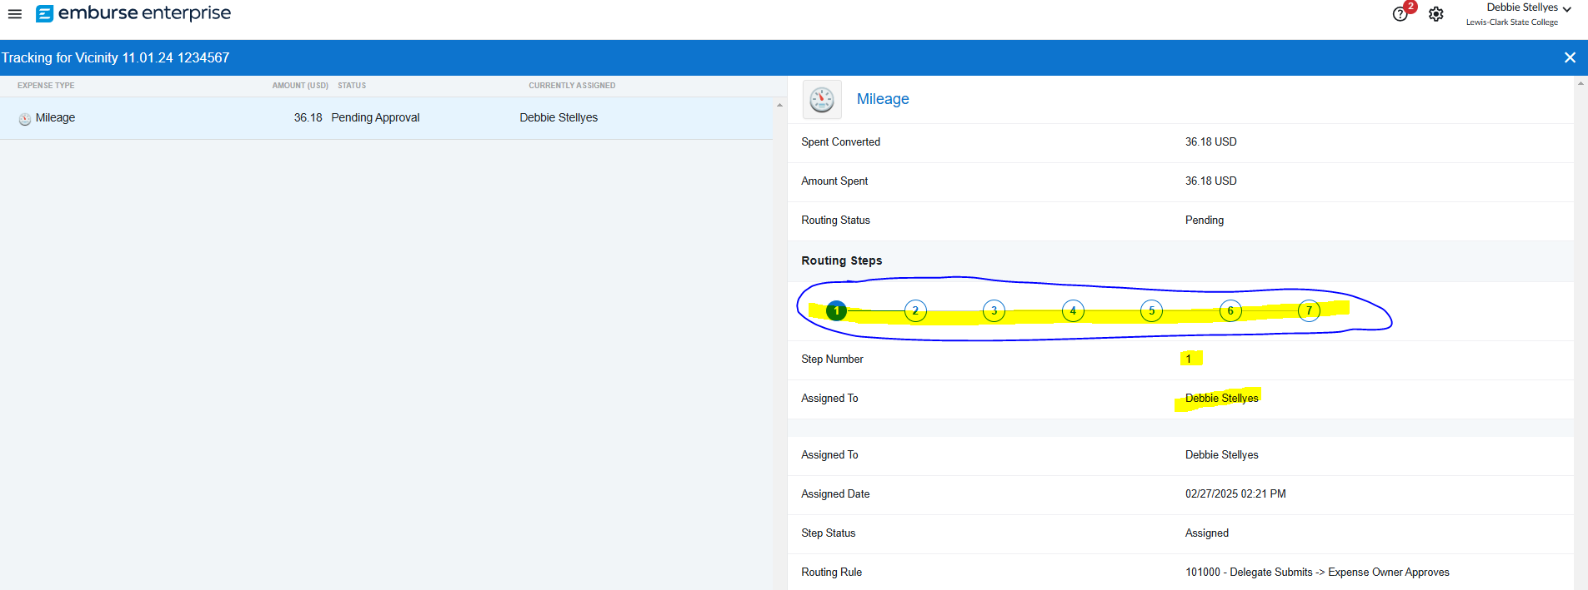
Tracking your items
This will show you the status on where the report is sitting.
On this example
1 is the traveler
2 is the Account String Verification in Colleague
3 is the Supervisor
4 is the Cost Center Owner
5 is the Travel Desk
6 & 7 is the auto bot connecting to Colleague to create a voucher number

Slide 33
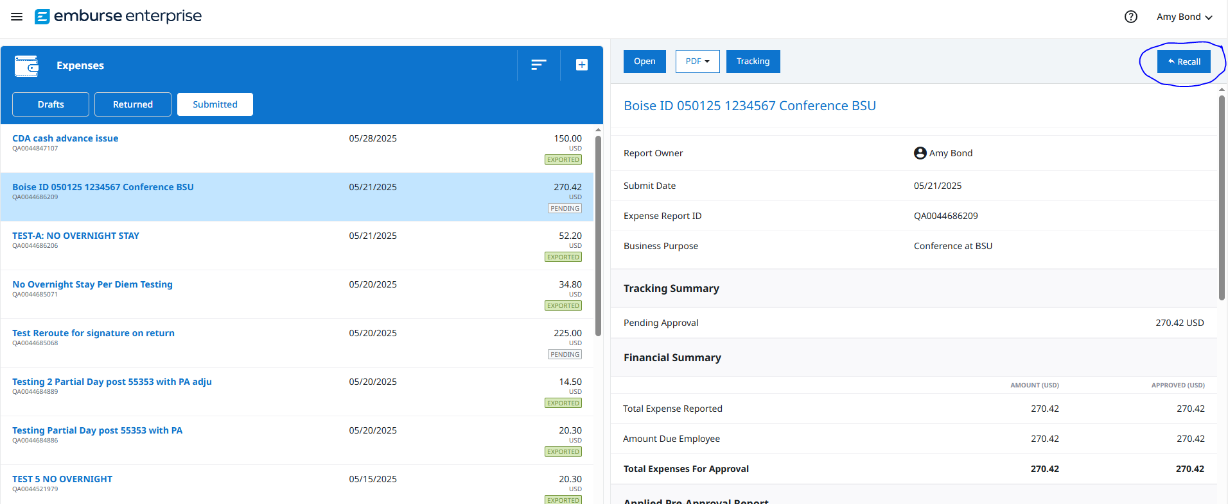
Recall Expense Report
You can only recall an Expense Report that is not fully approved status (Exported). Click on report name you are looking for and then click on Recall button top right-hand corner of screen. This will bring back into a draft form to resubmit. This will cause the report to go back through the approval process.

Slide 34

Thank you. Questions?
COTravel@lcsc.edu
208-792-2689

