Slide 1

Emburse
Pre-Approval Process
Travel System

Slide 2
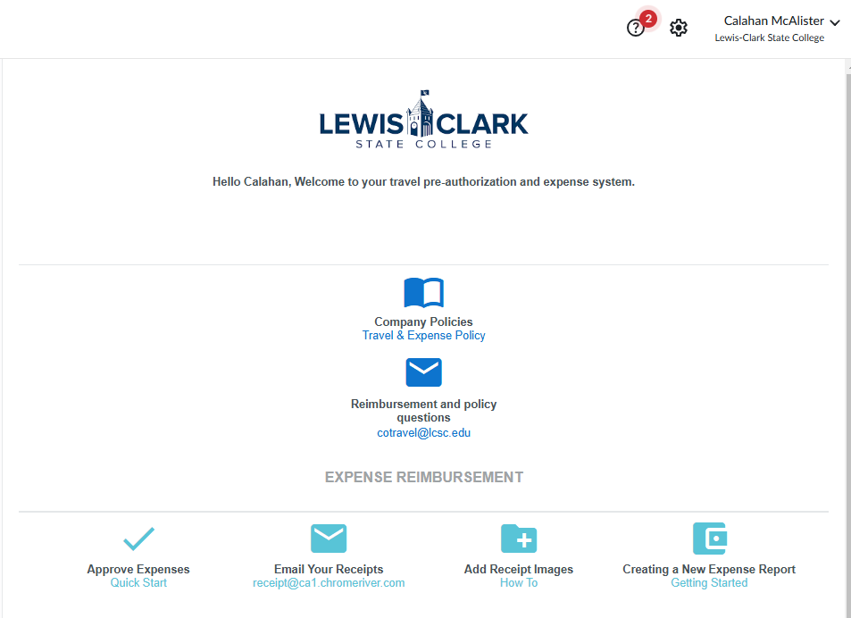
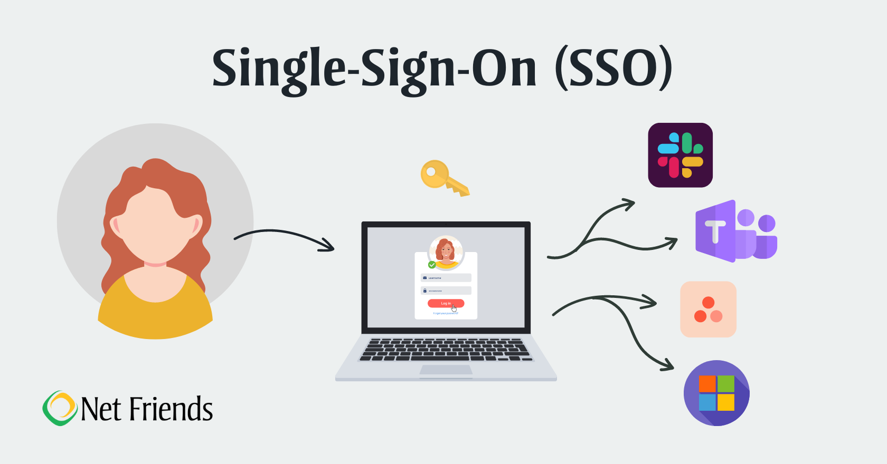


Logging Into Emburse- Production
Login will utilize single sign on verification
https://app.ca1.chromeriver.com/login/sso/saml?idp=lcsc.edu

Slide 3
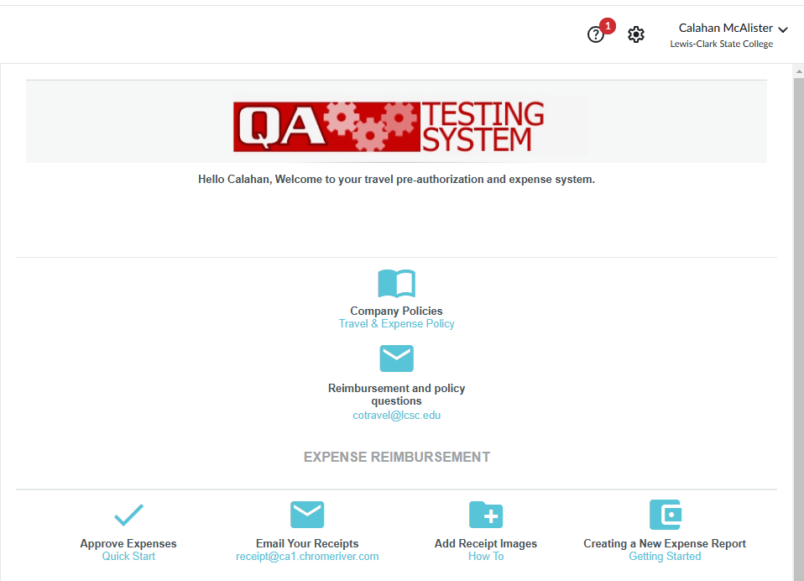
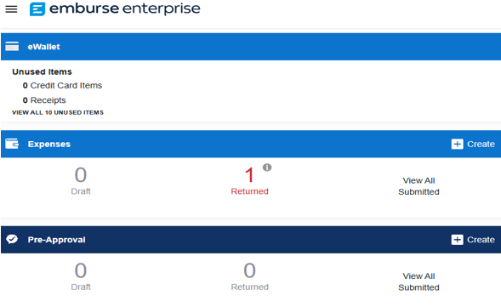
Creating Pre-Approval
Use Create button to start a Pre-Approval

Slide 4
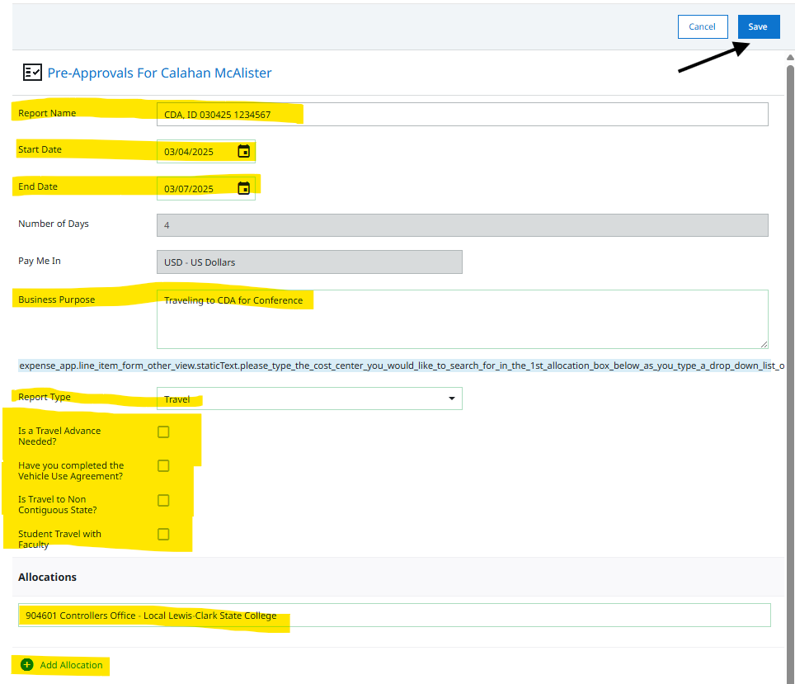
Creating Pre-Approval
Fill in the following information:
Report Name (Location, First date of travel, Warrior ID number)
Start and end date
Business Purpose
Report Type
Click any boxes that apply
Allocations (Cost Center)
Click Save when done

Slide 5
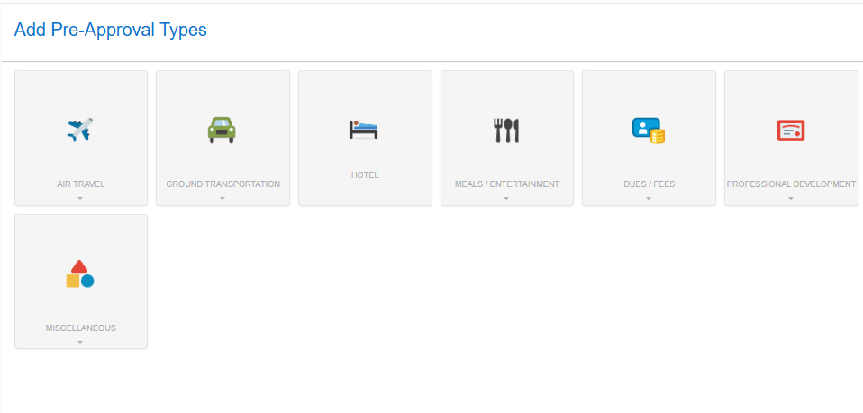
Add Pre-Approval
Estimates
Use tiles provided to add estimated totals to Pre-Approval
Air Travel
Ground Transportation
Hotel
Meals/Entertainment
Dues/Fees
Professional Development
Miscellaneous
Most expenses are estimates with just a total entered. A few require more information like Mileage (if using provided map) and Meals- Per Diem Wizard.

Slide 6
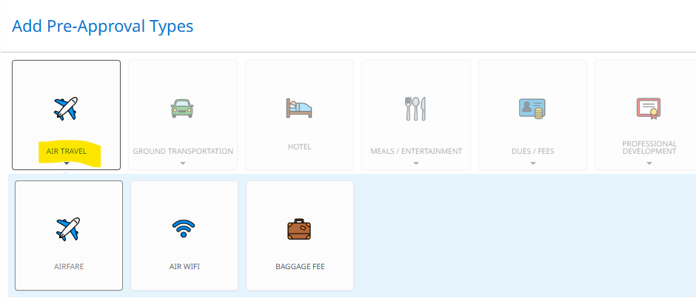
Add Pre-Approval
Estimates
Air Travel
Airfare
Air WIFI
Baggage Fee

Slide 7
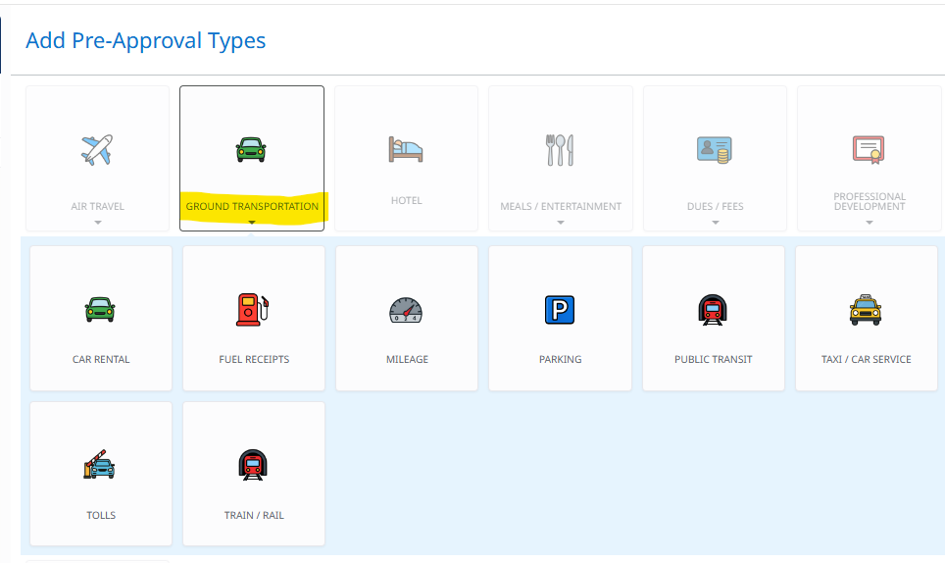
Add Pre-Approval
Estimates
Ground Transportation
Car Rental
Fuel Receipts
Mileage (for driving personal vehicle)
Parking
Public Transit
Taxi/ Car Service (including ride shares like Uber/Lyft)
Tolls
Train / Rail

Slide 8
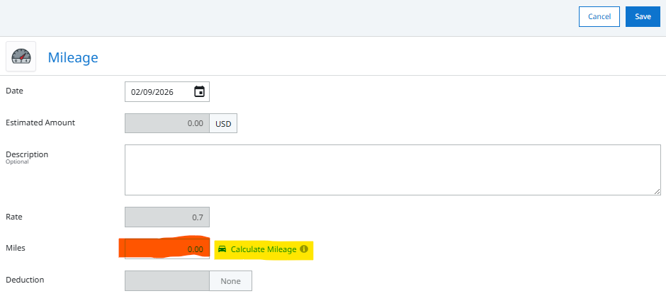
Add Pre-Approval
Estimates
Using mileage for personal vehicle
If you want to use Google maps as supporting mileage
Click on Calculate Mileage
Or use estimated miles for driving personal vehicle
Supporting documents will be required for Expense Report

Slide 9
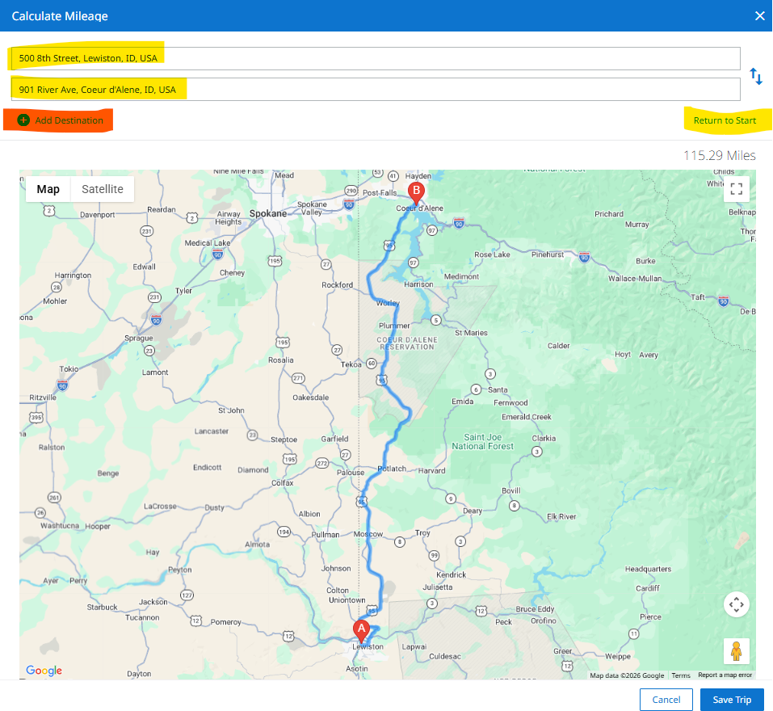
Add Pre-Approval
Estimates
Using Google maps to support mileage for Personal Vehicle
Type start address
Type end address
Click on Return to Start to auto calculate a return
Or you can use Add Destination to add additional locations

Slide 10
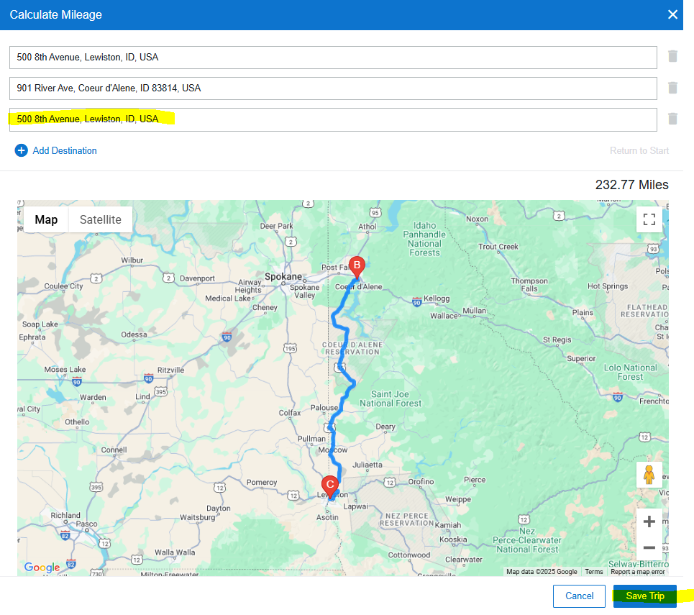
Add Pre-Approval
Estimates
Using Google maps to support mileage for Personal Vehicle
Click Save Trip when done

Slide 11
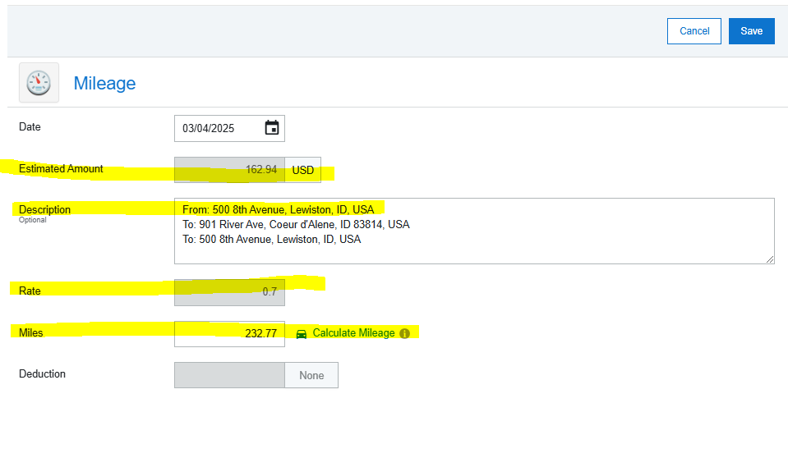
Add Pre-Approval
Estimates
Using Google maps to support mileage for Personal Vehicle
This will auto load
Estimated Amount
Description
Mileage Rate
Miles

Slide 12
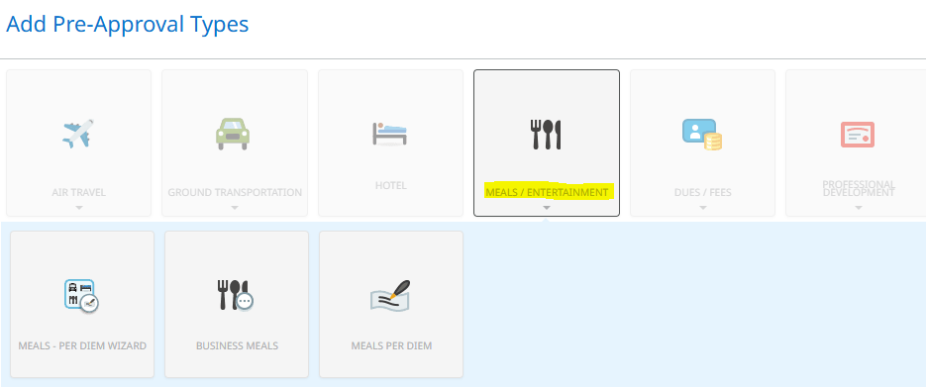
Add Pre-Approval
Estimates
Meals / Entertainment
Meals- Per Diem Wizard (main one to use)
Business Meals
Meals per Diem (estimate)

Slide 13
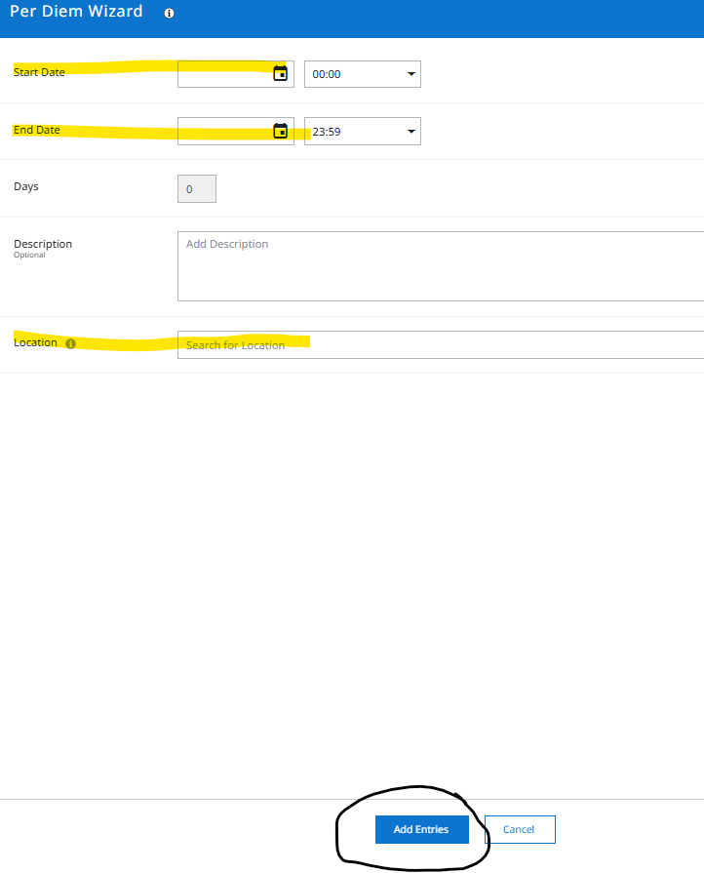
Add Pre-Approval
Estimates
Using Per Diem Wizard
Start Date and time if desired
Time is in 24-hour clock; 2 PM = 14:00
End Date and time if desired
Location
Click “Add Entities”

Slide 14
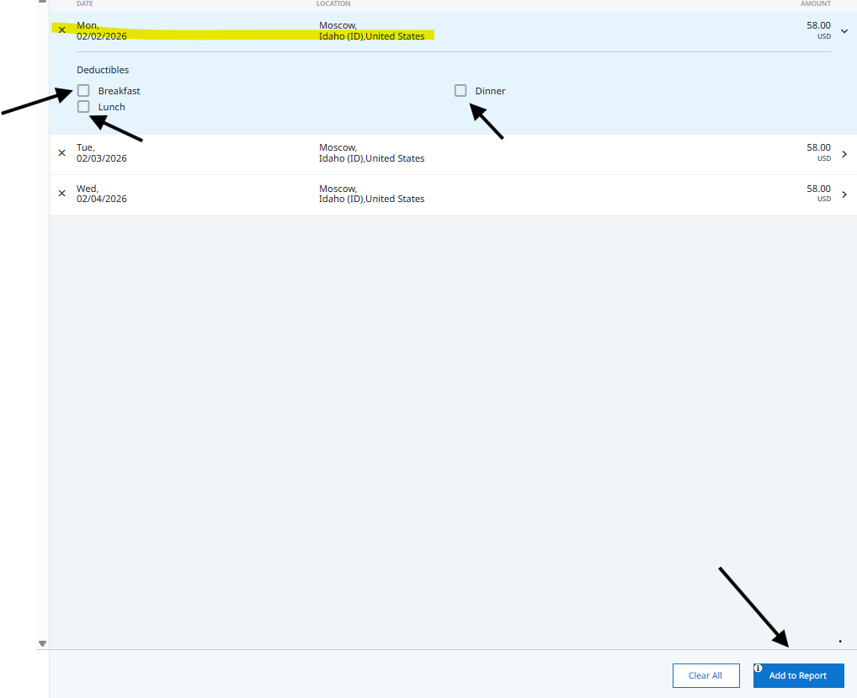
Add Pre-Approval
Estimates
Using Per Diem Wizard
This will bring up Per Diem on right hand side
You can leave as full day Per Diem and adjust when doing Expense Report
Or you can click on each day and select what you don’t want paid
Once completed click “Add to Report”

Slide 15
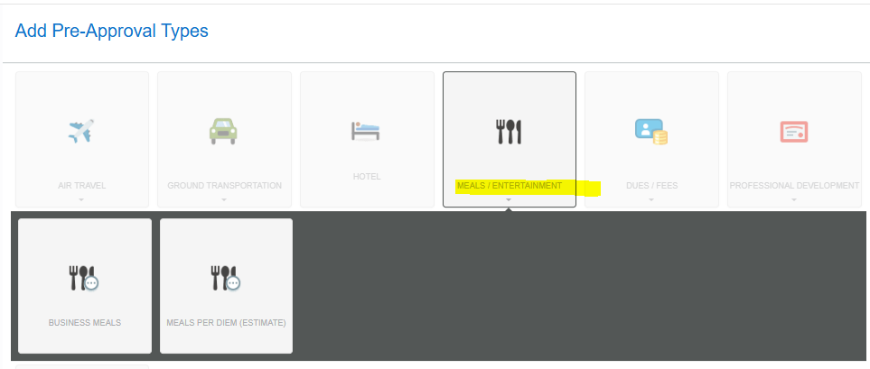
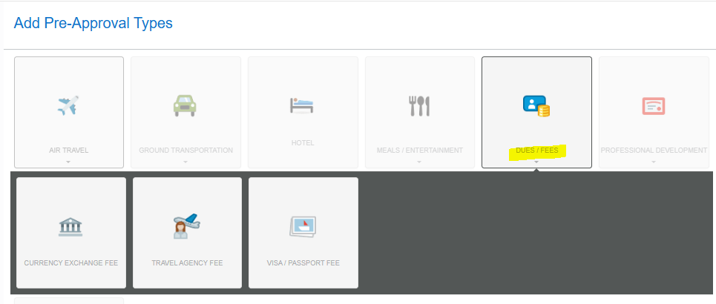
Add Pre-Approval
Estimates
Dues / Fees
Currency Exchange Fee
Travel Agency Fee
Visa / Passport Fee

Slide 16
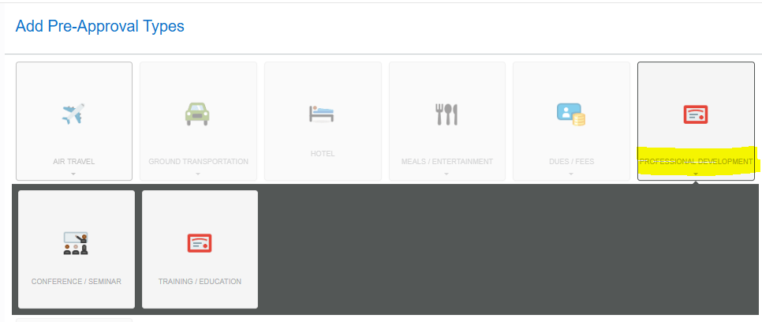
Add Pre-Approval
Estimates
Professional Development
Conference / Seminar
Training / Education

Slide 17
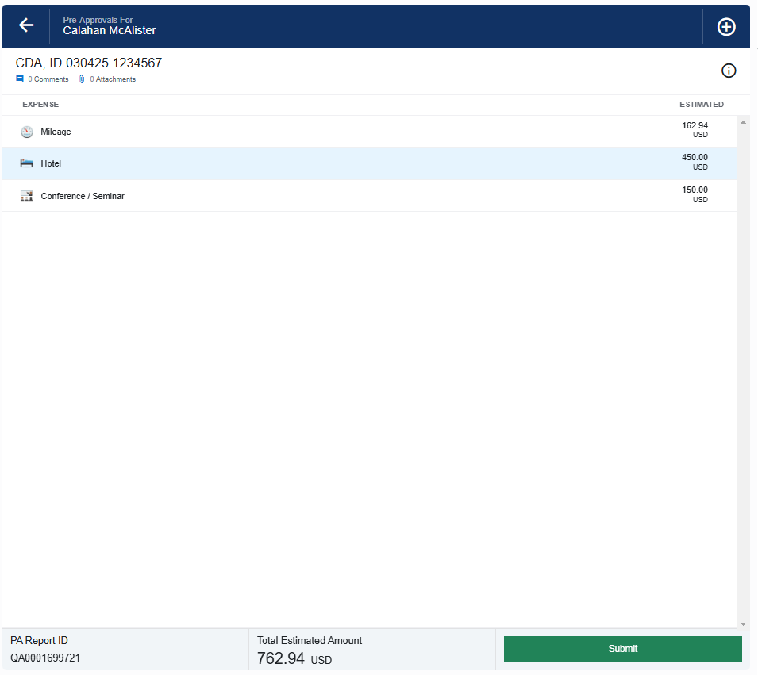
Before Clicking Submit
Double check report
Once Complete
You will see;
Title of Pre-Authorization
Expense Break down
Report ID
Total Expenses

Slide 18
Click Submit

Slide 19
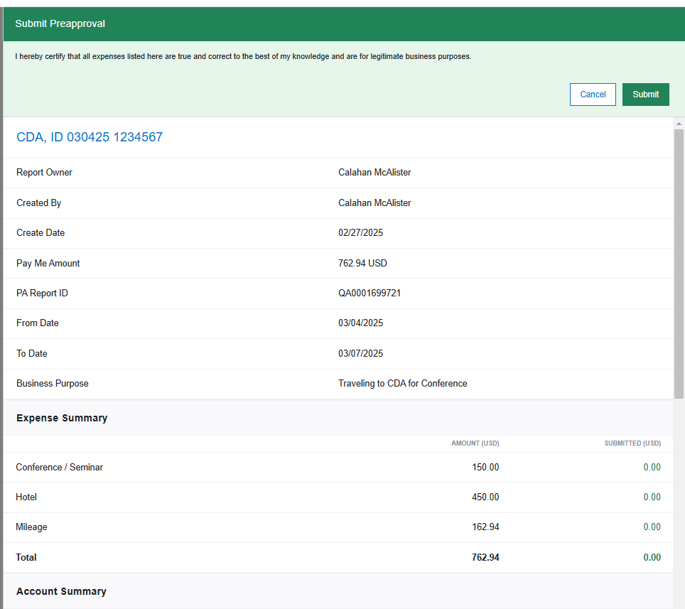
Verification Approval

Slide 20
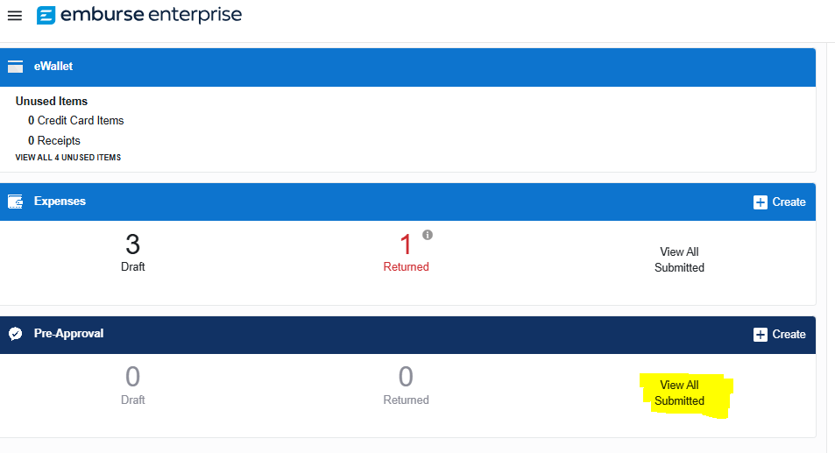
Tracking your items
A pre-approval can be tracked to see where it is in the process.

Slide 21
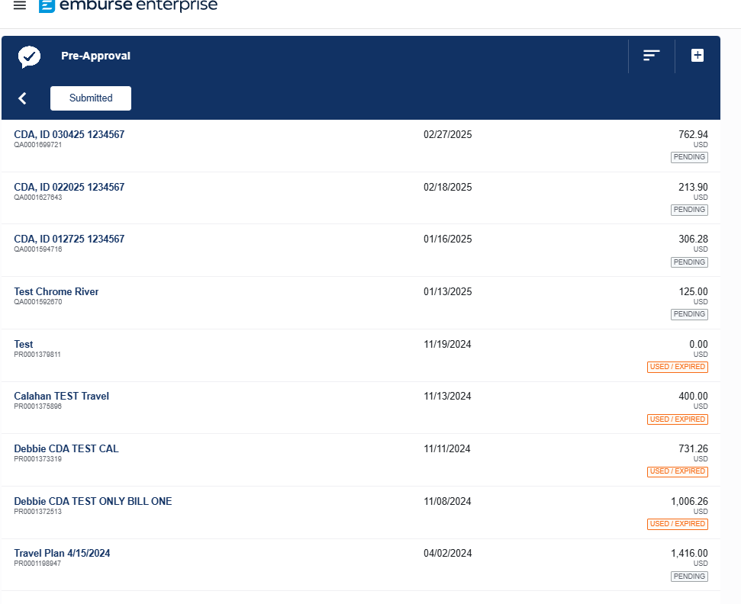
Tracking your items
A list will appear with all reports
Name of each report
Report ID number
Date Submitted
Total of expenses
Status of report

Slide 22
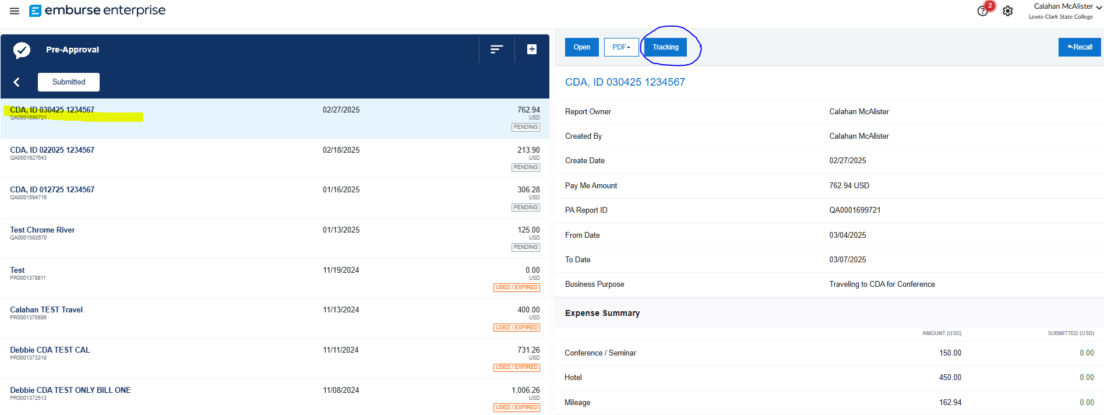
Tracking your items
Select from list and click on Tracking

Slide 23
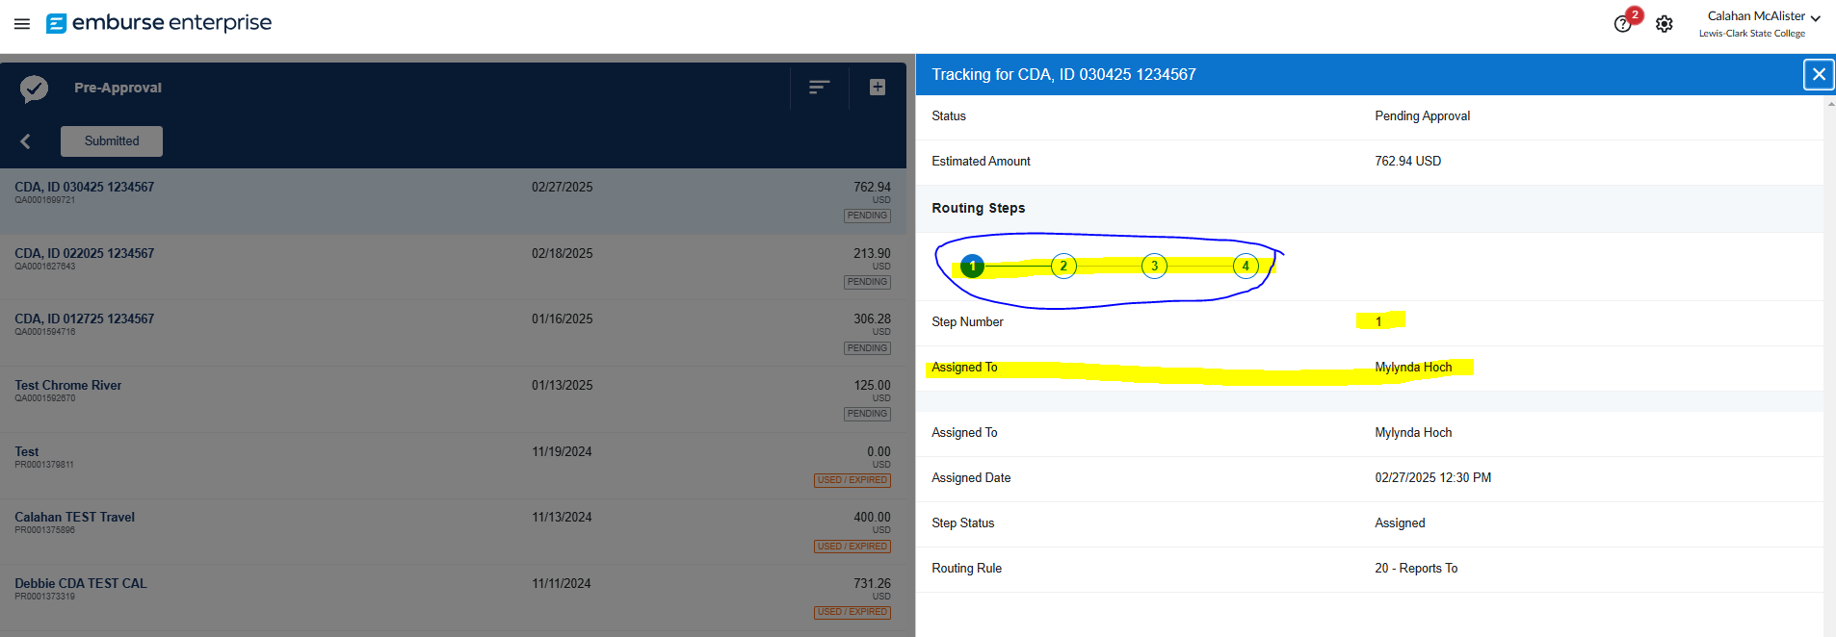
Tracking your items
This will show you the status on where the report is sitting.

Slide 24
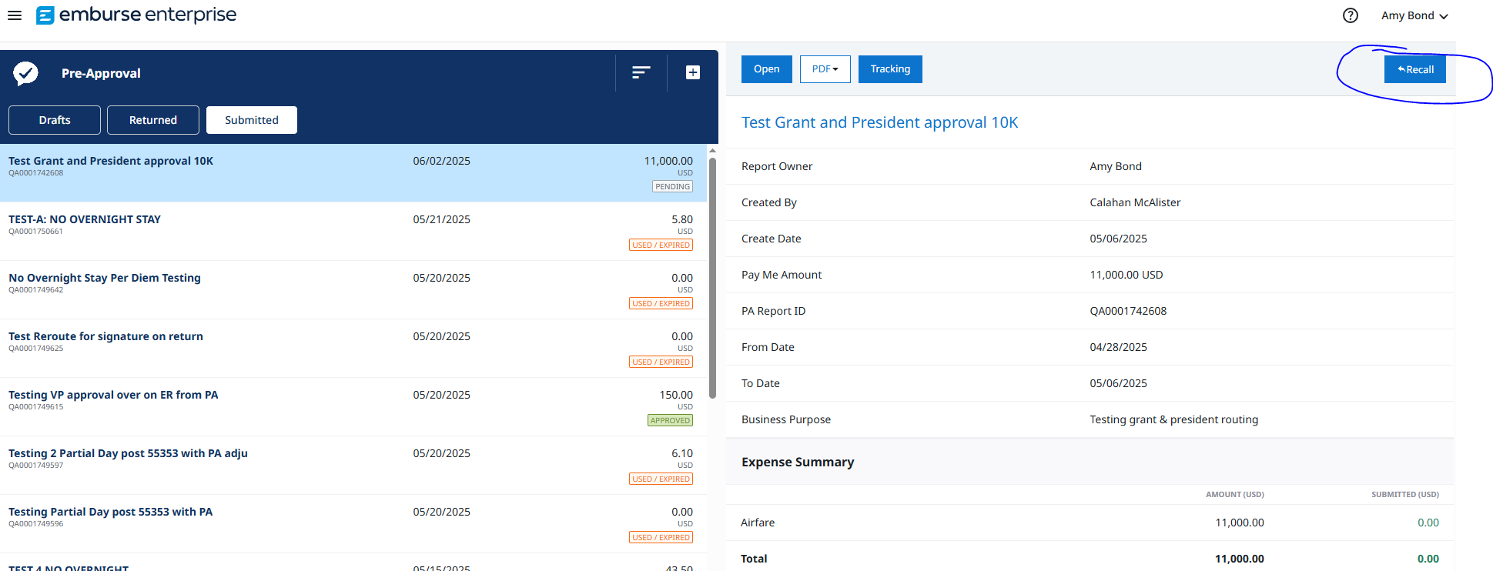
Recall Pre-Approval
You can only recall a Pre-Approval that is not fully approved or used/expired. Click on report you are looking for and then click on Recall button top right-hand corner of screen. This will bring back to a draft form and will require full approval process again.

Slide 25
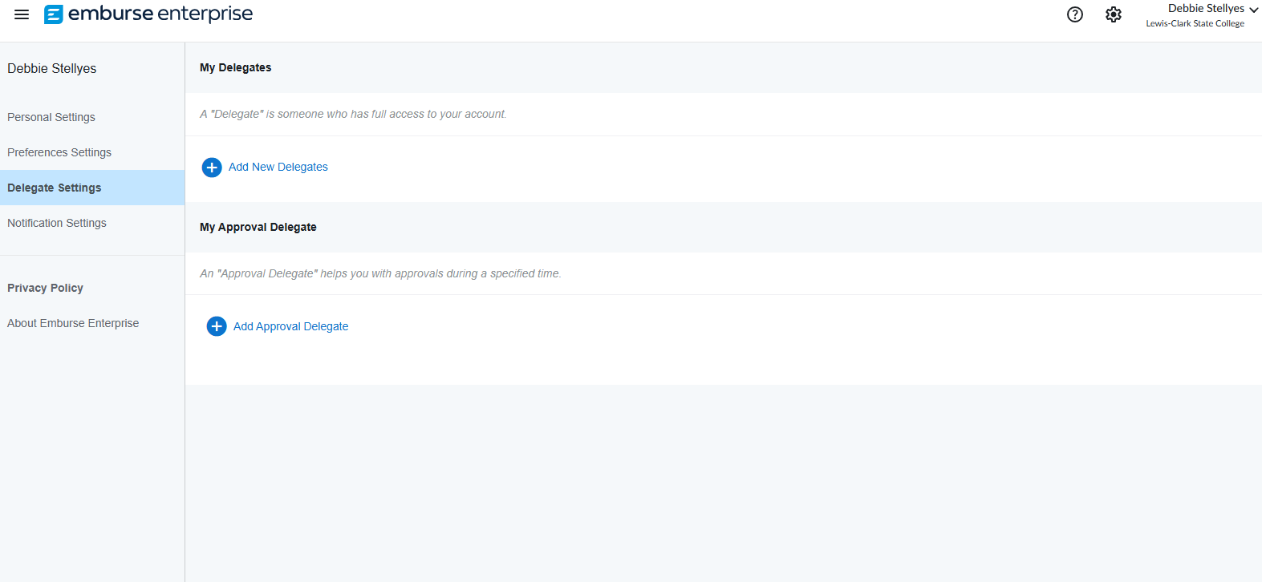
Assigning Delegates
Assign Pre-Authorization or Expense Report delegate (multiple)
Assign approval delegate (only one)
Start and end dates required
Click on your name – upper right-hand corner
Account settings
Delegate settings (left side)

Slide 26
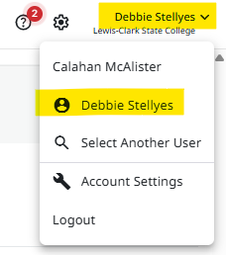
If submitting as Delegate
If you are an assigned delegate, make sure to click on your name in top right-hand corner and select person you would like to submit Pre-Approval for. Once selected, the top right-hand name will show the person’s name you are submitting for.

Slide 27
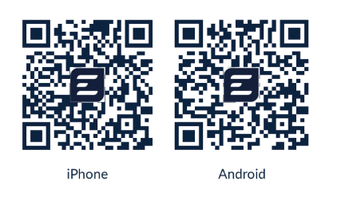
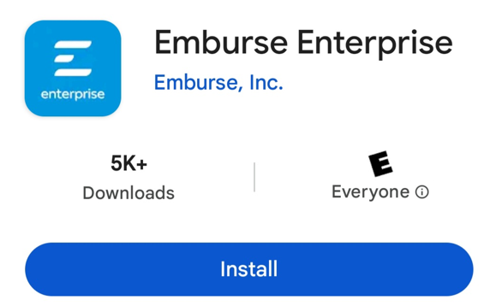
Emburse Enterprise App
(Only works with Production)
Download & Log In to Emburse Mobile App​
https://help.mobile.emburse.com/hc/en-us/articles/14257401226637-Download-and-Log-In-to-Emburse-Enterprise-Mobile
Use Single Sign On log in information
Use Full LCSC email EX CMMCALISTER@LCSC.EDU​
Password to computer log in
Might require DUO Verification

Slide 28
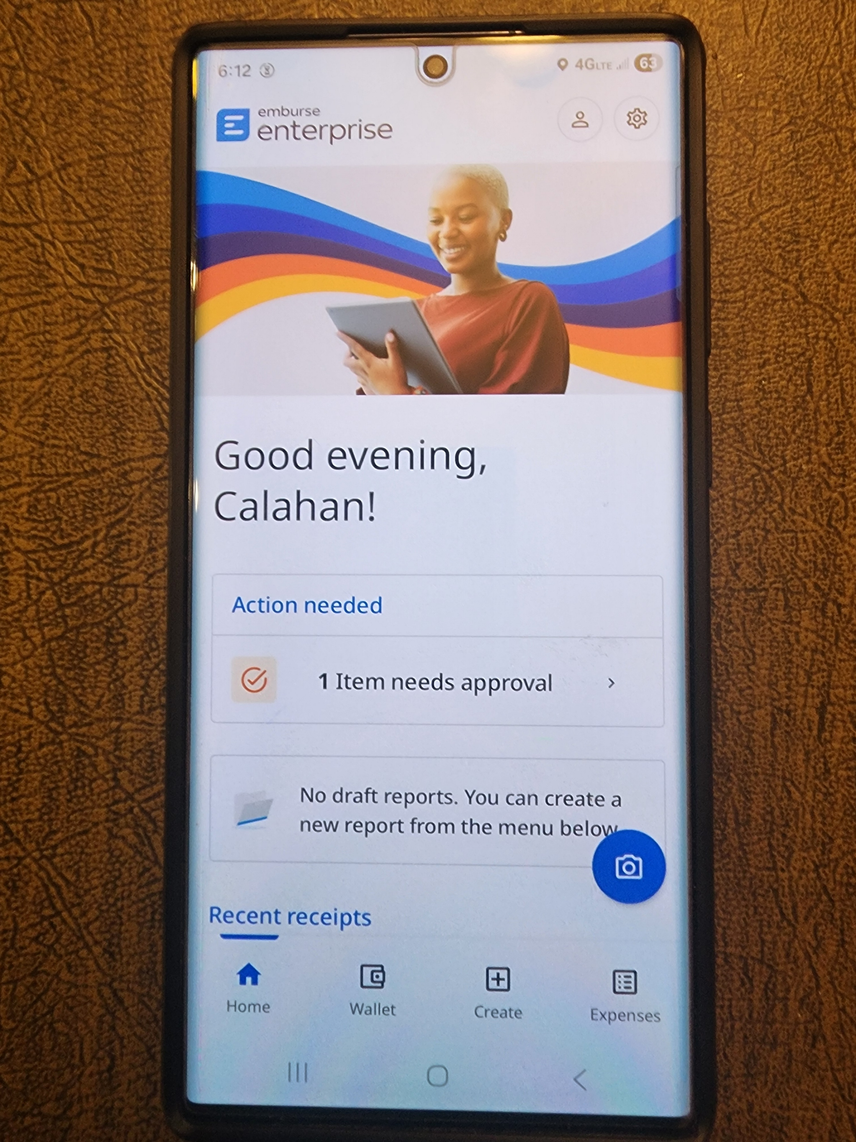
App Advantage
Account setting to assign Delegates on the Go
Create Pre-Approval or Expense Reports on the Go
Tracking and return to Draft on the Go

Slide 29

Thank you. Questions?
COTravel@lcsc.edu
208-792-2689

